Slide 1
A Sequential Abstraction for Data-parallelism in Hardware Accelerators
Akash Gaonkar -- 05/2021

Slide 2



Today’s applications use data-parallel operations
e.g., Gaussian Blur
e.g., Max-pooling
e.g., Part-of-speech Tagging
Natural Language Processing (NLP)
Image Processing
Machine Learning
Demand for efficiency => custom hardware (called accelerators)
Notes:
In today’s society, we are increasingly needing to perform data-parallel operations, for various applications, including image processing, machine learning, and natural language processing (NLP).
In machine learning in particular, ever-larger models and datasets require operations to be as efficient as possible, leading to design of custom hardware (called accelerators) optimized for machine learning.

Slide 3








Compilation to Hardware Accelerators
Applications provided in different DSLs
Compiler IR (e.g. Relay IRModule)
Executable/ runtime w/HW
Heterogeneous hardware backends
?
; CPU instructions
CMP r0, r1
SUBGT r0, r0, r1
BNE loop
; Access accel 1 (MMIO)
STR r2, 0xffff0000
LDR r3, 0xffff0010
; Access accel 2 (MMIO)
STR r4, 0xffff0100
LDR r5, 0xffff0110
; CPU instructions
MOV r3, r2
SUBGT r0, r0, r1
B lr
General purpose
huge gap!
FlexASR
No semantics for MMIO load/stores
Granularity mismatch
Custom numerics + memory
HLSCNN
Application specific
NVDLA
VTA
Notes:
This gap is the target of the Princeton ILA group (led by Sharad Malik). Emphasize these are loads and stores with meaning and side-effects (MMIO instructions). Know 3 challenges mentioned in CASES paper.

Slide 4

Instruction Level Abstraction (ILA)
Applications provided in different DSLs
Compiler IR (e.g. Relay IRModule)
Executable/ runtime w/HW
Heterogeneous hardware backends
; CPU instructions
CMP r0, r1
SUBGT r0, r0, r1
BNE loop
; Access accel 1 (MMIO)
STR r2, 0xffff0000
LDR r3, 0xffff0010
; Access accel 2 (MMIO)
STR r4, 0xffff0100
LDR r5, 0xffff0110
; CPU instructions
MOV r3, r2
SUBGT r0, r0, r1
B lr
General purpose
FlexASR
HLSCNN
Application specific
NVDLA
VTA
Instruction Level Abstraction (ILA) model
Instructions are commands at the MMIO interface of accelerators
Verified lifting of hardware operations
Huang, Bo-Yuan, et al. "ILAng: a modeling and verification platform for SoCs using instruction-level abstractions." International Conference on Tools and Algorithms for the Construction and Analysis of Systems. Springer, Cham, 2019.

Slide 5

Instruction Level Abstraction (ILA)
Applications provided in different DSLs
Compiler IR (e.g. Relay IRModule)
Relay-to-HW mapping via ILA models
Executable/ runtime w/HW
Heterogeneous hardware backends
FlexASR func A:
instr. 1 (STR r2, 0xffff0000)
instr. 2 (LDR r3, 0xffff0010)
; CPU instructions
CMP r0, r1
SUBGT r0, r0, r1
BNE loop
; Access accel 1 (MMIO)
STR r2, 0xffff0000
LDR r3, 0xffff0010
; Access accel 2 (MMIO)
STR r4, 0xffff0100
LDR r5, 0xffff0110
; CPU instructions
MOV r3, r2
SUBGT r0, r0, r1
B lr
FlexASR func B:
instr. 3 (STR r2, 0xffffaa00)
instr. 4 (LDR r3, 0xffffaabb)
General purpose
NVDLA func C:
instr. 5 (STR r4, 0xffff0100)
instr. 6 (LDR r5, 0xffff0110)
FlexASR
HLSCNN
Application specific
NVDLA
VTA
I extend the ILA methodology to model hardware data-parallelism.

Slide 6
Outline
Background: Instruction Level Abstraction (ILA)
SIMD (Single Instruction, Multiple Data) Instructions
Nested SIMD Instructions, SIMD Transformations
Key Points
Related Work
Future Work

Slide 7
Addressing the Specification Gap
Slide Credit: Sharad Malik
Lessons from Processor
Instruction Set Architecture (ISA)
ISA
Specifies visible state
- abstracts details
Modular specification
- set of instructions
, ILA
HW Abstraction
Software view of hardware
Defines semantics for SW interactions with HW
Enables SW verification
ISA .
, ILA
HW Specification
Specification for HW implementation
Enables implementation verification
Enables HW upgrades
ILA: Instruction-Level Abstractions
7
Notes:
Say ILA from Sharad Malik’s group “viewing upwards”, “viewing downwards”, (note to self: visible and persistent state – e.g. pipeline registers are not visible state)

Slide 8
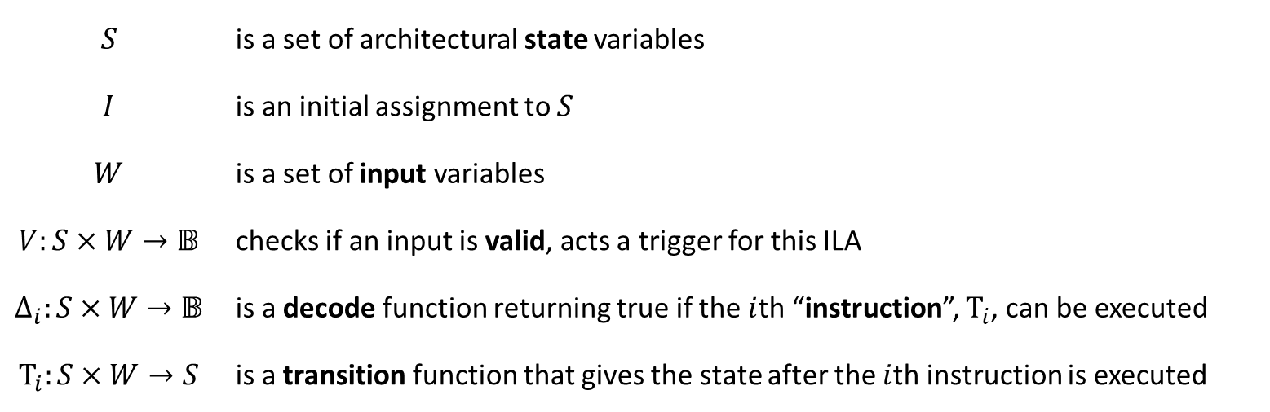
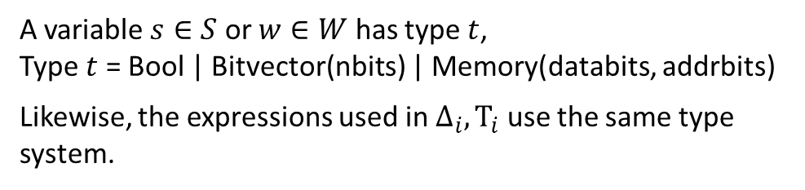
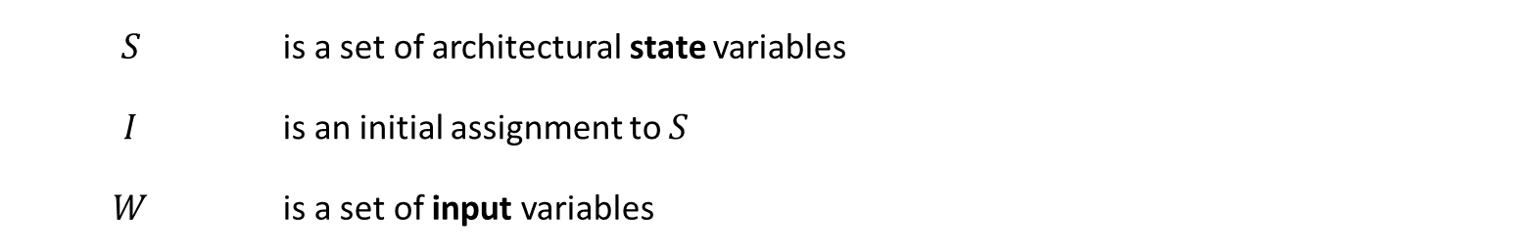
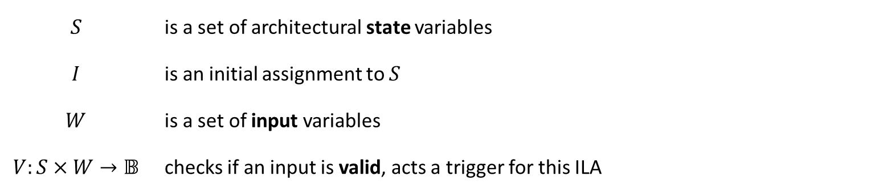
Background: Instruction Level Abstraction (ILA)
An ILA is a tuple $\left(S, I, W, V,{\left\{Δ_{i}\right\}}_{i∈\left[n\right]},{\left\{Τ_{i}\right\}}_{i∈\left[n\right]}\right)$ where
$$S$$ | is a set of architectural state variables
$$I$$ | is an initial assignment to $S$
$$W$$ | is a set of input variables
$$V:S×W→𝔹$$ | checks if an input is valid, acts a trigger for this ILA
$$Δ_{i}:S×W→𝔹$$ | is a decode function returning true if the $i$th “instruction”, $Τ_{i}$, can be executed
$$Τ_{i}:S×W→S$$ | is a transition function that gives the state after the $i$th instruction is executed
$$S$$ | is a set of architectural state variables
$$I$$ | is an initial assignment to $S$
$$W$$ | is a set of input variables
$$V:S×W→𝔹$$ | checks if an input is valid, acts a trigger for this ILA
$$S$$ | is a set of architectural state variables
$$I$$ | is an initial assignment to $S$
$$W$$ | is a set of input variables
A variable $s∈S$ or $w∈W$ has type $t$, Type $t$ = Bool | Bitvector(nbits) | Memory(databits, addrbits)
Likewise, the expressions used in $Δ_{i}, Τ_{i}$ use the same type system.
Modified from Huang et al. TODAES’18: elided instruction fetching.
Notes:
If hierarchy needed, mention in the last bullet, “ILA also supports hierarchy”
To explain: ILAs model a piece of hardware as a labeled state transition system. On types: note that these are traditional types for hardware models, which have never needed to describe operations on large complex pieces of data – that is until accelerators, and data-parallel accelerators in particular, started including somewhat custom representations of vectors and matrices with added complications like tiling.

Slide 9

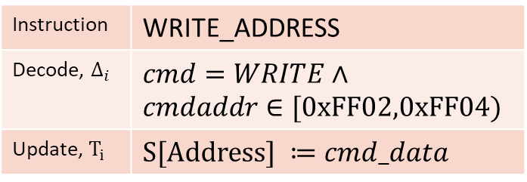
Example ILA for an AES Accelerator
AES Block Encryption
Specifies visible state
- architectural register
- memory
Modular specification
- set of instructions
Instruction specification
- update to architectural states
Visible State
Address
Interconnect
Interface
Length
Key
Counter
Status
Instructions $≈$ Interface Commands
Write, 0xff00, 0x1 | START_ENCRYPT
Write, 0xff02,data | WRITE_ADDRESS
Write, 0xff04,data | WRITE_LENGTH
Write, 0xff10,data | WRITE_KEY
Write, 0xff20,data | WRITE_COUNTER
Read, 0xff01 | GET_STATUS
Read, 0xff02 | READ_ADDRRESS
Read, 0xff04 | READ_LENGTH
Instruction | WRITE_ADDRESS
Decode, $Δ_{i}$ | $cmd=WRITE∧$ $cmdaddr∈[0xFF02,0xFF04)$
Update, $Τ_{i}$ | $S[Address] ≔cmd_data$
Notes:
Can note that START_ENCRYPT is a special MMIO write, note that many instructions are for config. Can use Tau[i] to point out Address is a state variable and cmd_data is an input

Slide 10
Key themes in current ILA methodology
ILA bridges the hardware-software boundary
ILAs allow us to formally reason about both hardware and software
This lets us verify properties about the interaction between an accelerator and a program
ILA maintains sequential programming abstractions
ILAs have a single thread of control
ILAs are deterministic: after fetching input, exactly one instruction’s decode condition holds
How do we extend ILA to model data-parallelism in accelerators?
Can we maintain the view of sequential abstractions (to ease verification)?
Notes:
On point 1, mention serves as both a specification and an abstraction
Can verbally say what the savings are. “We don’t want our verifier to have to start reasoning about interleavings – it’s too expensive.”

Slide 11
Outline
Background: Instruction Level Abstraction (ILA)
SIMD (Single Instruction, Multiple Data) Instructions
Nested SIMD Instructions, SIMD Transformations
Key Points
Related Work
Future Work

Slide 12
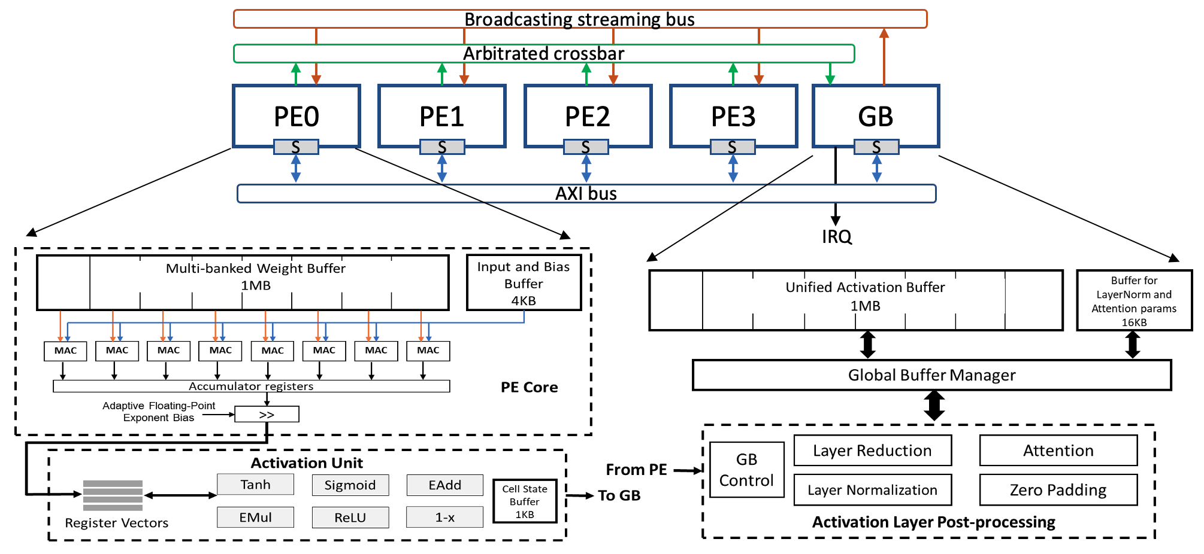
Challenge example: FlexASR Accelerator
Tambe, Thierry, et al. "9.8 A 25mm 2 SoC for IoT Devices with 18ms Noise-Robust Speech-to-Text Latency via Bayesian Speech Denoising and Attention-Based Sequence-to-Sequence DNN Speech Recognition in 16nm FinFET." 2021 IEEE International Solid-State Circuits Conference (ISSCC). Vol. 64. IEEE, 2021. Image credit: https://github.com/harvard-acc/FlexASR
Notes:
Already given general motivation. Stick to “challenge example” – don’t say specifically this example. Two goals: model data-parallelism, maintain sequential view.

Slide 13

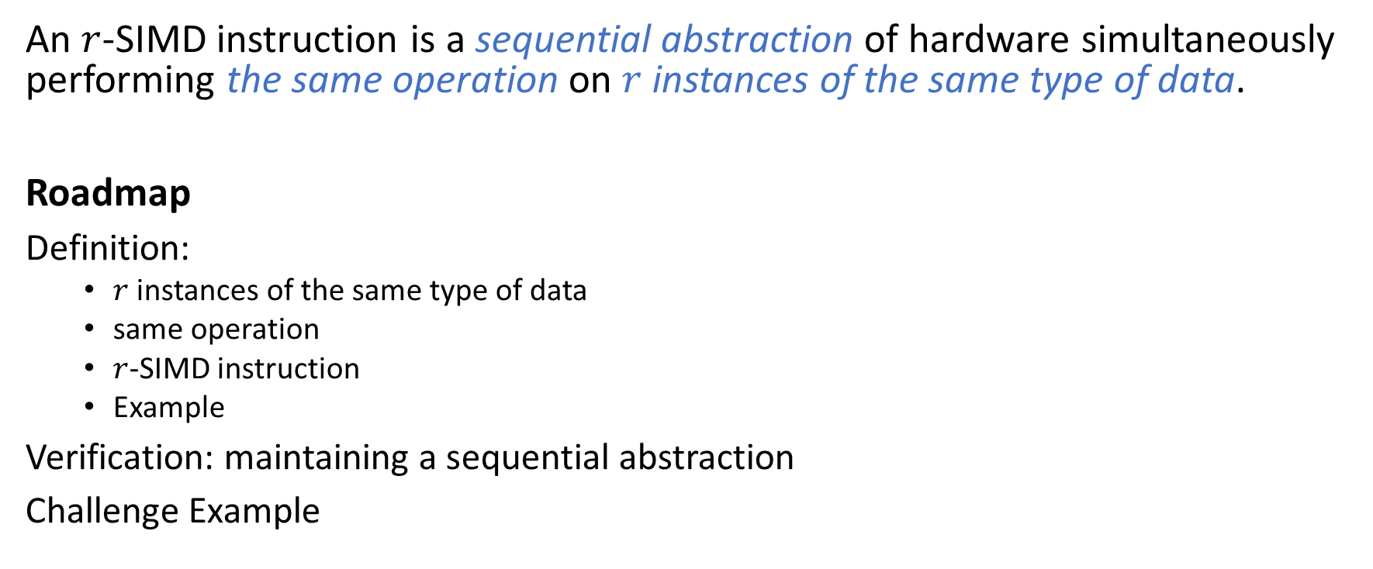








SIMD Instructions: Roadmap
An $r$-SIMD instruction is a sequential abstraction of hardware simultaneously performing the same operation on $r$ instances of the same type of data.
Roadmap
Definition:
$r$ instances of the same type of data
same operation
$r$-SIMD instruction
Example
Verification: maintaining a sequential abstraction
Challenge Example
$W_{0}$
$W_{1}$
$W_{r−1}$
…
$S_{0}$
$S_{1}$
$S_{r−1}$
$S_{0}′$
$S_{1}′$
…
$S_{r−1}′$
Notes:
Explain notation in figure

Slide 14

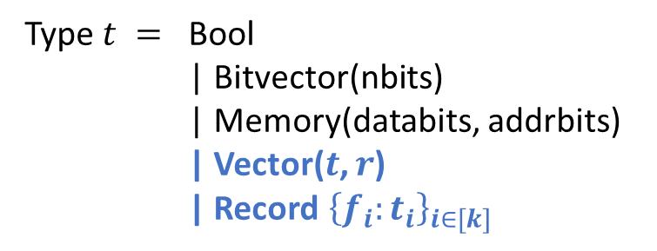



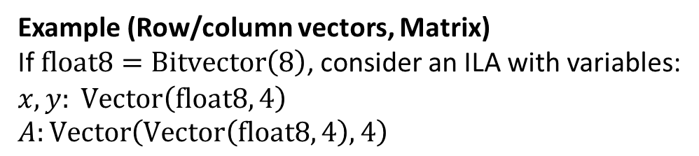
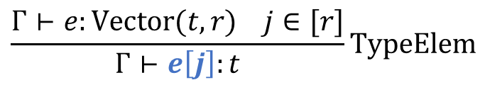



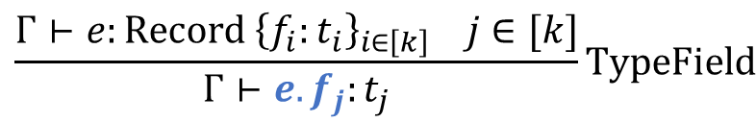



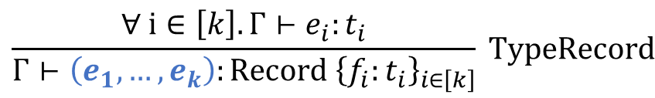
$r$ instances of the same type of data
$W_{r−1}$
$W_{1}$
$W_{2}$
…
$S_{1}$
$S_{2}$
$S_{r−1}$
$S_{1}′$
$S_{2}′$
…
$S_{r−1}′$
We extend our type system:
$$\frac{Γ⊢e:\text{Vector}(t, r) j∈[r]}{Γ⊢e\left[j\right]:t}\text{TypeElem}$$
Type $t =$ | Bool | Bitvector(nbits) | Memory(databits, addrbits) | Vector($t$, $r$) | Record${\left\{f_{i}:t_{i}\right\}}_{i∈[k]}$
$$\frac{∀ i∈\left[k\right]. Γ⊢e_{i}:t_{i}}{Γ⊢\left(e_{1},…, e_{k}\right):\text{Record} {\left\{f_{i}:t_{i}\right\}}_{i∈\left[k\right]}} \text{TypeRecord}$$
$$\frac{Γ⊢e:\text{Record} {\left\{f_{i}:t_{i}\right\}}_{i∈\left[k\right]} j∈[k]}{Γ⊢e.f_{j}:t_{j}}\text{TypeField}$$
Example (Row/column vectors, Matrix) If $\text{float}\text{8}=\text{Bitvector}\left(8\right)$, consider an ILA with variables: $x, y: \text{Vector}\left(\text{float}\text{8}, 4\right)$ $A:\text{Vector}\left(\text{Vector}\left(\text{float}\text{8}, 4\right), 4\right)$
Notes:
Highlight the meaning of t and r in the vector, explain I’ve included the typing judgements to establish a notation. Know 3 challenges mentioned in CASES paper. Take opportunity to mention float8 is an example of custom numerics taken from FlexASR.

Slide 15
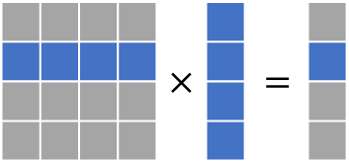


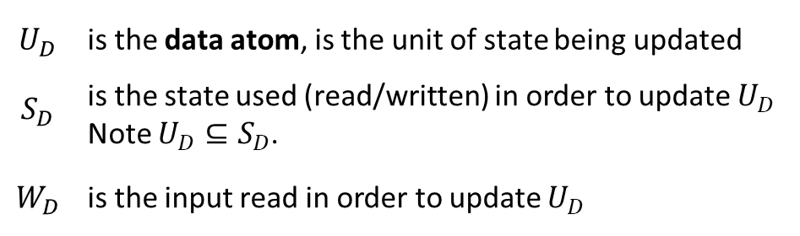
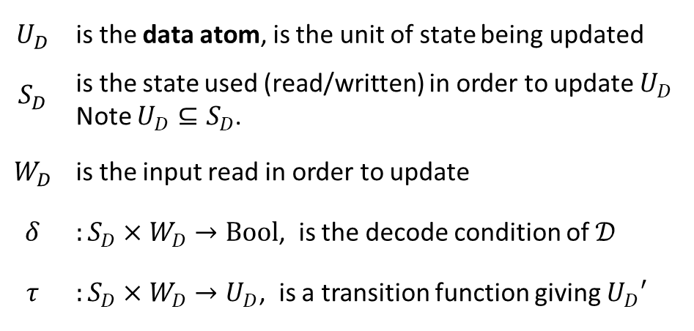



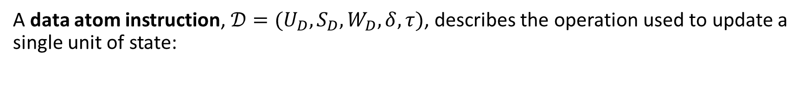


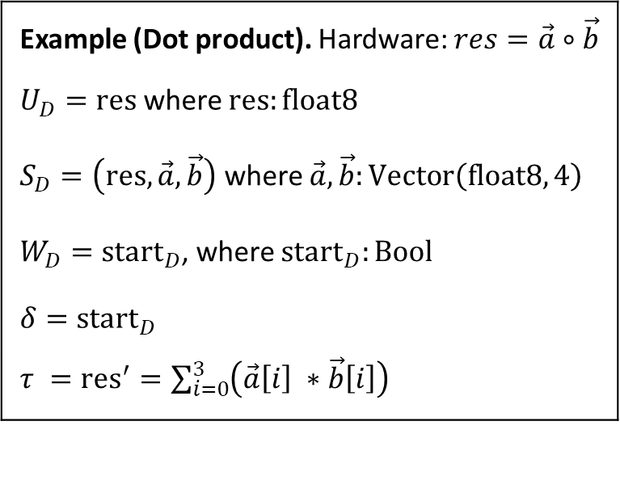


Same operation
$W_{1}$
$W_{2}$
$W_{r−1}$
…
$S_{1}$
$S_{2}$
$S_{r−1}$
$S_{1}′$
$S_{2}′$
…
$S_{r−1}′$
A data atom instruction, $𝒟=({U_{D}, S}_{D},W_{D},δ,τ)$, describes the operation used to update a single unit of state:
Example (Dot product). Hardware: $res=\vec{a}∘\vec{b}$
$U_{D}=\text{res}$ where $\text{res}:\text{float}\text{8}$
$S_{D}=\left(\text{res}, \vec{a}, \vec{b}\right)$ where $\vec{a}, \vec{b}:\text{Vector}\left(\text{float}\text{8}, 4\right)$
$W_{D}={\text{start}}_{D}$, where ${\text{start}}_{D}:\text{Bool}$
$δ={\text{start}}_{D}$
$τ ={\text{res}}^{′}=\sum_{i=0}^{3}{\left(\vec{a}\left[i\right] ∗\vec{b}\left[i\right]\right)}$
$$U_{D}$$ | is the data atom, is the unit of state being updated
$$S_{D}$$ | is the state used (read/written) in order to update $U_{D}$ Note $U_{D}⊆S_{D}$.
$$W_{D}$$ | is the input read in order to update
$$δ$$ | $:S_{D}×W_{D}→\text{Bool}$, is the decode condition of $𝒟$
$$τ$$ | $:S_{D}×W_{D}→U_{D}$, is a transition function giving $U_{D}′$
$$U_{D}$$ | is the data atom, is the unit of state being updated
$$S_{D}$$ | is the state used (read/written) in order to update $U_{D}$ Note $U_{D}⊆S_{D}$.
$$W_{D}$$ | is the input read in order to update $U_{D}$
$$U_{D}$$ | is the data atom, is the unit of state being updated
Notes:
Just like a regular ILA instruction, with well defined scope so that each instance can be defined parametrically in terms of its…

Slide 16
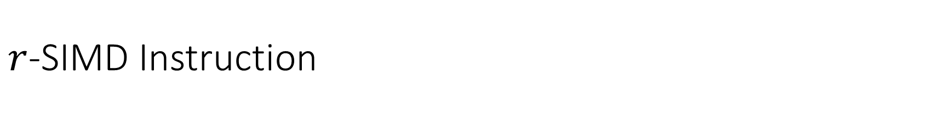
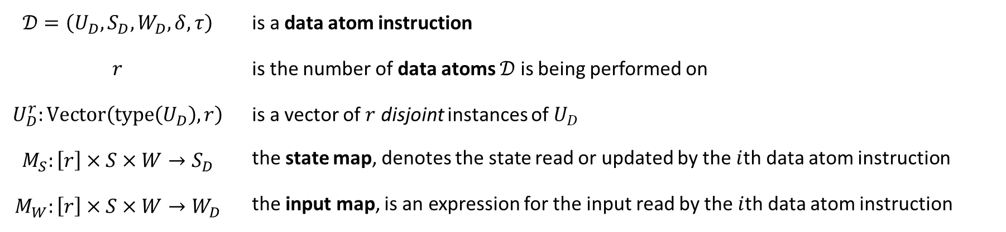
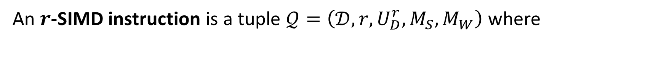
$r$-SIMD Instruction
$W_{1}$
$W_{2}$
$W_{r−1}$
…
$S_{1}$
$S_{2}$
$S_{r−1}$
$S_{1}′$
$S_{2}′$
…
$S_{r−1}′$
An $r$-SIMD instruction is a tuple $𝒬=\left(𝒟,r,U_{D}^{r}, M_{S},M_{W}\right)$ where
$$𝒟=\left(U_{D}, S_{D},W_{D}, δ, τ\right)$$ | is a data atom instruction
$$r$$ | is the number of data atoms $𝒟$ is being performed on
$$U_{D}^{r}:\text{Vector}\left(\text{type}\left(U_{D}\right), r\right)$$ | is a vector of $r$ disjoint instances of $U_{D}$
$$M_{S}:\left[r\right]×S×W→S_{D}$$ | the state map, denotes the state read or updated by the $i$th data atom instruction
$$M_{W}:\left[r\right]×S×W→W_{D}$$ | the input map, is an expression for the input read by the $i$th data atom instruction
Notes:
We don’t

Slide 17


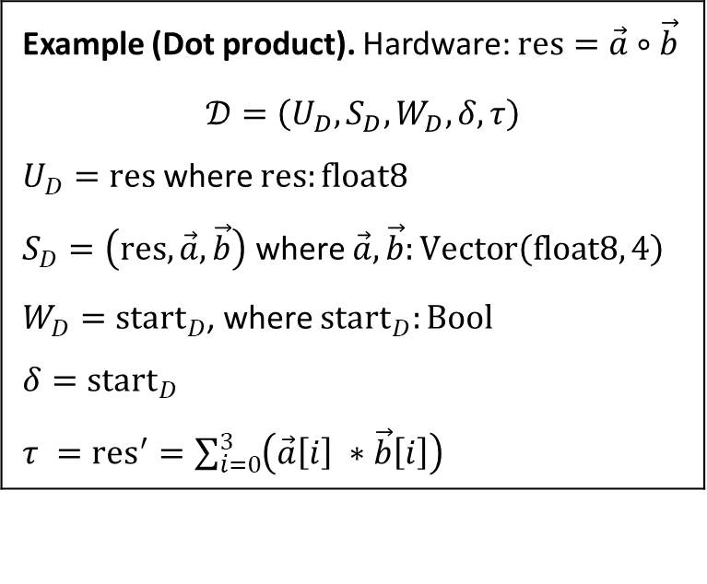






Example $r$-SIMD Instruction: Linear Transformation
Hardware: $y=Ax$, using $r=4$ parallel operations.
Example (Dot product). Hardware: $\text{res}=\vec{a}∘\vec{b}$
$$𝒟=\left(U_{D},S_{D},W_{D}, δ, τ\right)$$
$U_{D}=\text{res}$ where $\text{res}:\text{float}\text{8}$
$S_{D}=\left(\text{res}, \vec{a}, \vec{b}\right)$ where $\vec{a},\vec{b}:\text{Vector}\left(\text{float}\text{8}, 4\right)$
$W_{D}={\text{start}}_{D}$, where ${\text{start}}_{D}:\text{Bool}$
$δ={\text{start}}_{D}$
$τ ={\text{res}}^{′}=\sum_{i=0}^{3}{\left(\vec{a}\left[i\right] ∗\vec{b}\left[i\right]\right)}$
$$×$$
$$=$$
$$A$$
$$x$$
$$y$$
$$\text{Vector}\left(\text{Vector}\left(\text{float}\text{8}, 4\right), 4\right)$$
$$\text{Vector}\left(\text{float}\text{8}, 4\right)$$
We model this hardware operation with the SIMD instruction: $$𝒬=\left(𝒟, r=4, U_{D}^{r}=y,M_{S}(i, S,W)=\left(y\left[i\right], A\left[i\right], x\right),M_{W}=\text{start}\right)$$

Slide 18
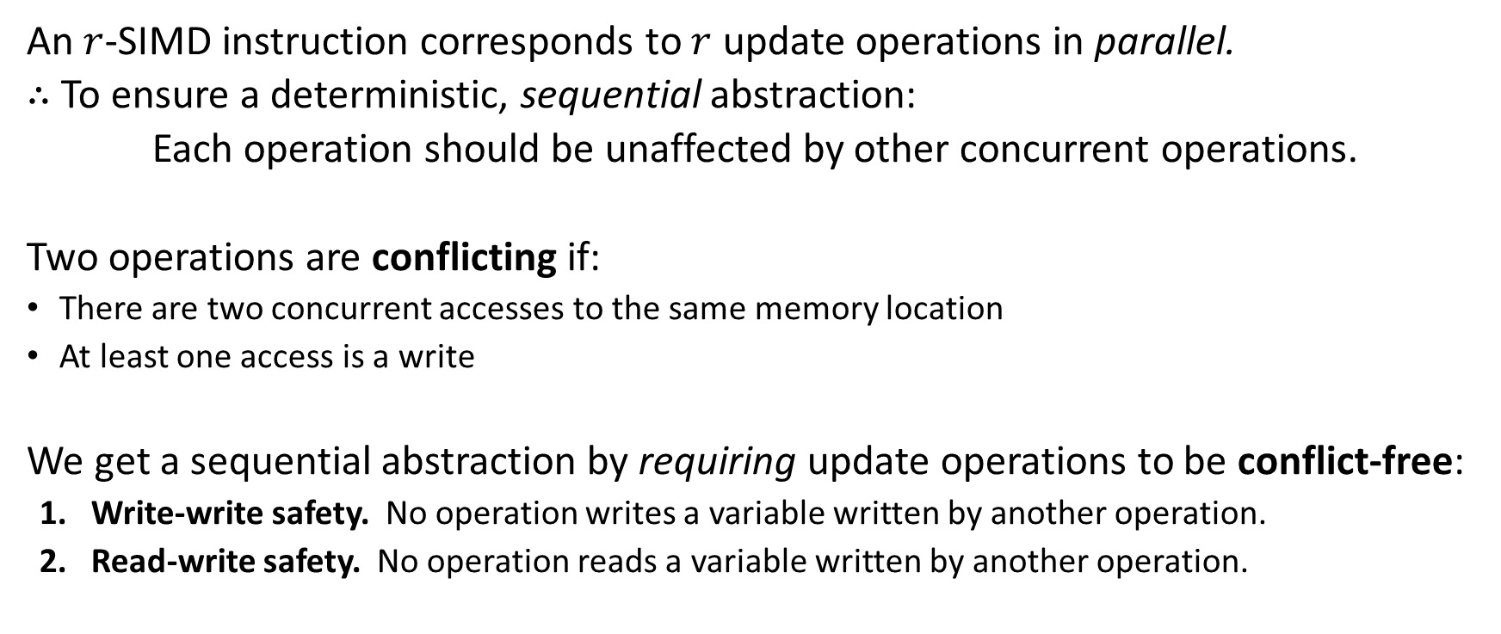
Maintaining a sequential abstraction
An $r$-SIMD instruction corresponds to $r$ update operations in parallel.
$∴$ To ensure a deterministic, sequential abstraction:
Each operation should be unaffected by other concurrent operations.
Two operations are conflicting if:
There are two concurrent accesses to the same memory location
At least one access is a write
We get a sequential abstraction by requiring update operations to be conflict-free:
Write-write safety. No operation writes a variable written by another operation.
Read-write safety. No operation reads a variable written by another operation.
Notes:
Remember: A conflict is two concurrent accesses to the same memory location, at least one of which is a write

Slide 19
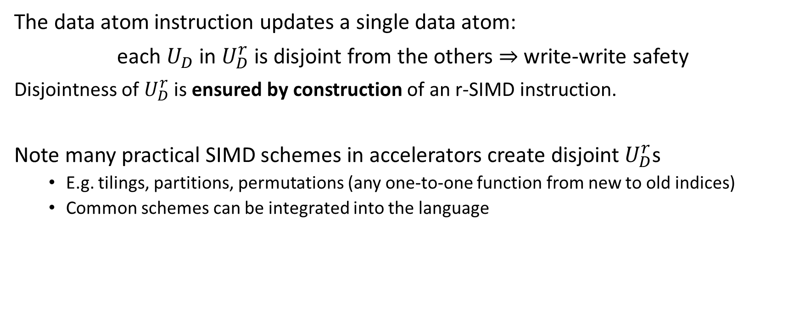
Write-write safety is maintained by construction
The data atom instruction updates a single data atom:
each $U_{D}$ in $U_{D}^{r}$is disjoint from the others $⇒$ write-write safety
Disjointness of $U_{D}^{r}$ is ensured by construction of an r-SIMD instruction.
Note many practical SIMD schemes in accelerators create disjoint $U_{D}^{r}$s
E.g. tilings, partitions, permutations (any one-to-one function from new to old indices)
Common schemes can be integrated into the language
Notes:
If design decisions are questioned, emphasize practicality over generality

Slide 20

Read-write safety check
For a SIMD instruction $𝒬=\left(𝒟,r,U_{D}^{r}, M_{S},M_{W}\right)$,
Compute read and written variables of $𝓓$: $\text{rd}\left(𝒟\right), \text{wr}\left(𝒟\right)$
Substitute $M_{S}, M_{W}$ to get read/written variables used to update $𝓠$’s $i$th data atom:
$$\text{r}\text{d}\left(𝒬,i\right)=\text{rd}\left(𝒟\right)\left[M_{S}\left(i, S,W\right)\text{/}S_{D}\right]\left[M_{W}\left(i, S,W\right)\text{/}W_{D}\right]∪\text{rd}\left(M_{S}\right)∪\text{rd}\left(M_{W}\right)$$
$$\text{wr}\left(𝒬,i\right)=\text{wr}\left(𝒟\right)\left[M_{S}\left(i,S,W\right)\text{/}S_{D}\right]\left[M_{W}\left(i, S,W\right)\text{/}W_{D}\right]$$
(Pairwise comparison) Verify read and written variables are disjoint for two arbitrary, different data atoms: $∀ i,j∈\left[r\right]. \left(i≠j⇒\text{rd}\left(𝒬,i\right)∩\text{wr}\left(𝒬,j\right)=∅\right)$

Slide 21
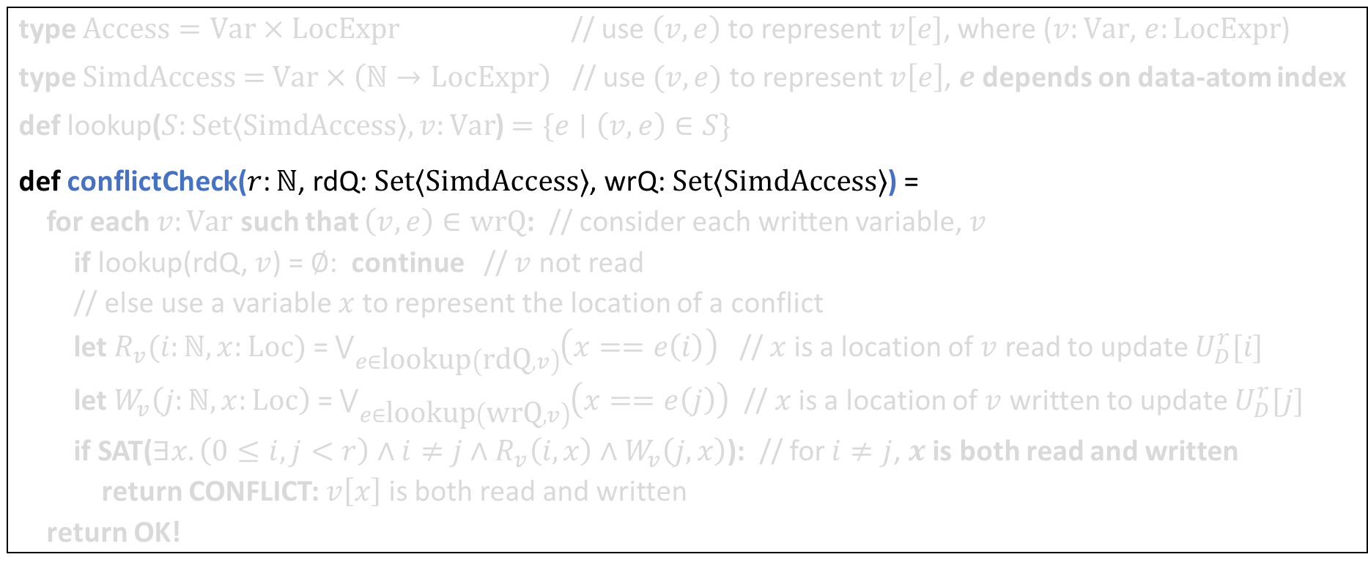
Conflict-freedom check: SMT encoding
Verify: $∀ i,j∈\left[r\right]. \left(i≠j⇒\text{rd}\left(𝒬,i\right)∩\text{wr}\left(𝒬,j\right)=∅\right)$
type $\text{Access}=\text{Var}×\text{LocExpr}$ // use $\left(v, e\right)$ to represent $v[e]$, where ($v:\text{Var}$, $e:\text{LocExpr}$)
type $Simd\text{Access}\text{ = }\text{Var}×\left(ℕ→\text{LocExpr}\right)$ // use $(v, e)$ to represent $v\left[e\right]$, $e$ depends on data-atom index
def lookup($S:\text{Set}⟨\text{SimdAccess}⟩, v:\text{Var}$) $=\{e∣\left(v, e\right)∈S\}$
def conflictCheck($r$: $ℕ$, rdQ: $\text{Set}⟨\text{SimdAccess}⟩$, wrQ: $\text{Set}⟨\text{Simd}\text{Access}⟩$) =
for each $v:\text{Var}$ such that $\left(v, e\right)∈\text{wrQ}$: // consider each written variable, $v$
if lookup(rdQ, $v$) = $∅$: continue // $v$ not read
// else use a variable $x$ to represent the location of a conflict
let $R_{v}(i:ℕ, x:\text{Loc})$ = $\bigvee_{e∈\text{lookup}\left(\text{rdQ}, v\right)}{\left(x==e\left(i\right)\right)}$ // $x$ is a location of $v$ read to update $U_{D}^{r}[i]$
let $W_{v}\left(j:ℕ, x:\text{Loc}\right)$ = $\bigvee_{e∈\text{lookup}\left(\text{wr}\text{Q}, v\right)}{\left(x==e\left(j\right)\right)}$ // $x$ is a location of $v$ written to update $U_{D}^{r}[j]$
if SAT($∃x.\left(0≤i, j<r\right)∧i≠j∧R_{v}\left(i, x\right)∧W_{v}\left(j, x\right)$): // for $i≠j$, $x$ is both read and written
return CONFLICT: $v\left[x\right]$ is both read and written
return OK!

Slide 22
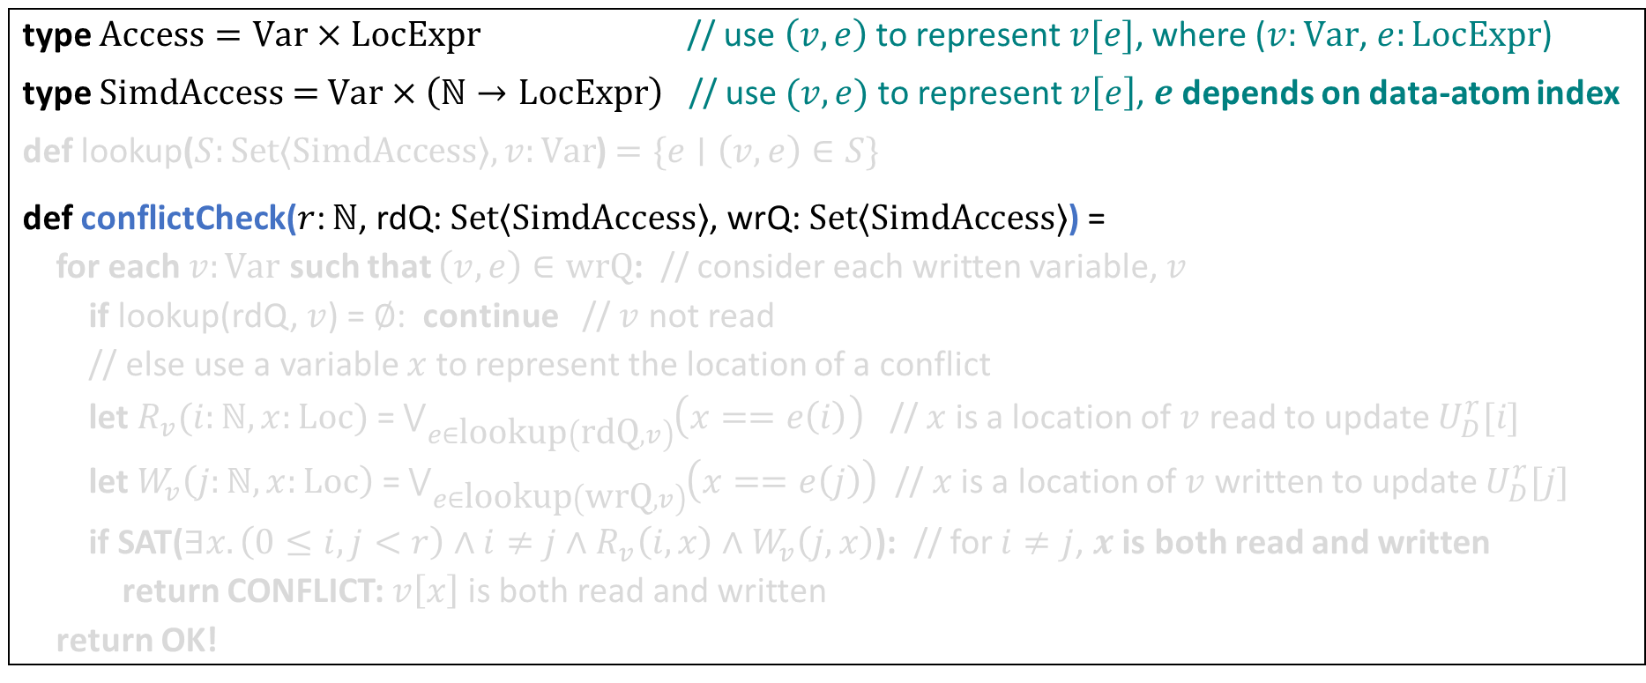
Conflict-freedom check: SMT encoding
Verify: $∀ i,j∈\left[r\right]. \left(i≠j⇒\text{rd}\left(𝒬,i\right)∩\text{wr}\left(𝒬,j\right)=∅\right)$
type $\text{Access}=\text{Var}×\text{LocExpr}$ // use $\left(v, e\right)$ to represent $v[e]$, where ($v:\text{Var}$, $e:\text{LocExpr}$)
type $Simd\text{Access}\text{ = }\text{Var}×\left(ℕ→\text{LocExpr}\right)$ // use $(v, e)$ to represent $v\left[e\right]$, $e$ depends on data-atom index
def lookup($S:\text{Set}⟨\text{SimdAccess}⟩, v:\text{Var}$) $=\{e∣\left(v, e\right)∈S\}$
def conflictCheck($r$: $ℕ$, rdQ: $\text{Set}⟨\text{SimdAccess}⟩$, wrQ: $\text{Set}⟨\text{Simd}\text{Access}⟩$) =
for each $v:\text{Var}$ such that $\left(v, e\right)∈\text{wrQ}$: // consider each written variable, $v$
if lookup(rdQ, $v$) = $∅$: continue // $v$ not read
// else use a variable $x$ to represent the location of a conflict
let $R_{v}(i:ℕ, x:\text{Loc})$ = $\bigvee_{e∈\text{lookup}\left(\text{rdQ}, v\right)}{\left(x==e\left(i\right)\right)}$ // $x$ is a location of $v$ read to update $U_{D}^{r}[i]$
let $W_{v}\left(j:ℕ, x:\text{Loc}\right)$ = $\bigvee_{e∈\text{lookup}\left(\text{wr}\text{Q}, v\right)}{\left(x==e\left(j\right)\right)}$ // $x$ is a location of $v$ written to update $U_{D}^{r}[j]$
if SAT($∃x.\left(0≤i, j<r\right)∧i≠j∧R_{v}\left(i, x\right)∧W_{v}\left(j, x\right)$): // for $i≠j$, $x$ is both read and written
return CONFLICT: $v\left[x\right]$ is both read and written
return OK!

Slide 23
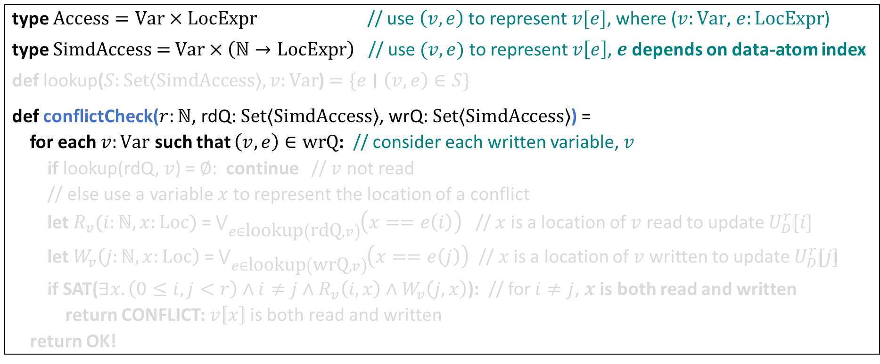
Conflict-freedom check: SMT encoding
Verify: $∀ i,j∈\left[r\right]. \left(i≠j⇒\text{rd}\left(𝒬,i\right)∩\text{wr}\left(𝒬,j\right)=∅\right)$
type $\text{Access}=\text{Var}×\text{LocExpr}$ // use $\left(v, e\right)$ to represent $v[e]$, where ($v:\text{Var}$, $e:\text{LocExpr}$)
type $Simd\text{Access}\text{ = }\text{Var}×\left(ℕ→\text{LocExpr}\right)$ // use $(v, e)$ to represent $v\left[e\right]$, $e$ depends on data-atom index
def lookup($S:\text{Set}⟨\text{SimdAccess}⟩, v:\text{Var}$) $=\{e∣\left(v, e\right)∈S\}$
def conflictCheck($r$: $ℕ$, rdQ: $\text{Set}⟨\text{SimdAccess}⟩$, wrQ: $\text{Set}⟨\text{Simd}\text{Access}⟩$) =
for each $v:\text{Var}$ such that $\left(v, e\right)∈\text{wrQ}$: // consider each written variable, $v$
if lookup(rdQ, $v$) = $∅$: continue // $v$ not read
// else use a variable $x$ to represent the location of a conflict
let $R_{v}(i:ℕ, x:\text{Loc})$ = $\bigvee_{e∈\text{lookup}\left(\text{rdQ}, v\right)}{\left(x==e\left(i\right)\right)}$ // $x$ is a location of $v$ read to update $U_{D}^{r}[i]$
let $W_{v}\left(j:ℕ, x:\text{Loc}\right)$ = $\bigvee_{e∈\text{lookup}\left(\text{wr}\text{Q}, v\right)}{\left(x==e\left(j\right)\right)}$ // $x$ is a location of $v$ written to update $U_{D}^{r}[j]$
if SAT($∃x.\left(0≤i, j<r\right)∧i≠j∧R_{v}\left(i, x\right)∧W_{v}\left(j, x\right)$): // for $i≠j$, $x$ is both read and written
return CONFLICT: $v\left[x\right]$ is both read and written
return OK!

Slide 24
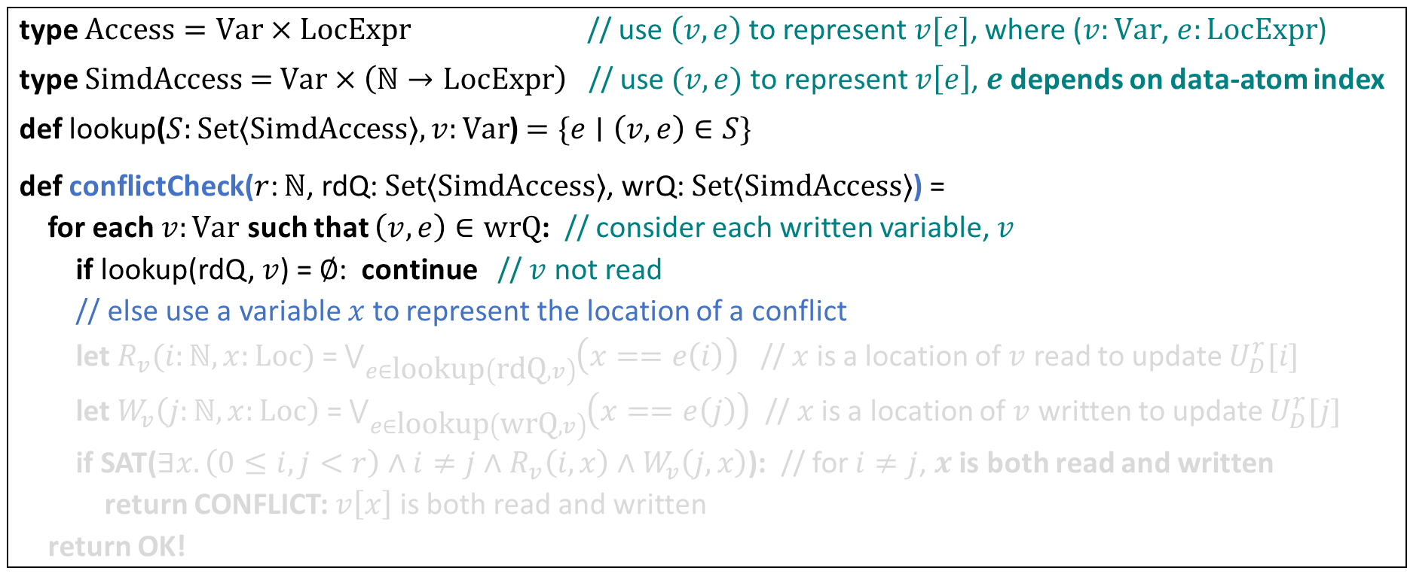
Conflict-freedom check: SMT encoding
Verify: $∀ i,j∈\left[r\right]. \left(i≠j⇒\text{rd}\left(𝒬,i\right)∩\text{wr}\left(𝒬,j\right)=∅\right)$
type $\text{Access}=\text{Var}×\text{LocExpr}$ // use $\left(v, e\right)$ to represent $v[e]$, where ($v:\text{Var}$, $e:\text{LocExpr}$)
type $Simd\text{Access}\text{ = }\text{Var}×\left(ℕ→\text{LocExpr}\right)$ // use $(v, e)$ to represent $v\left[e\right]$, $e$ depends on data-atom index
def lookup($S:\text{Set}⟨\text{SimdAccess}⟩, v:\text{Var}$) $=\{e∣\left(v, e\right)∈S\}$
def conflictCheck($r$: $ℕ$, rdQ: $\text{Set}⟨\text{SimdAccess}⟩$, wrQ: $\text{Set}⟨\text{Simd}\text{Access}⟩$) =
for each $v:\text{Var}$ such that $\left(v, e\right)∈\text{wrQ}$: // consider each written variable, $v$
if lookup(rdQ, $v$) = $∅$: continue // $v$ not read
// else use a variable $x$ to represent the location of a conflict
let $R_{v}(i:ℕ, x:\text{Loc})$ = $\bigvee_{e∈\text{lookup}\left(\text{rdQ}, v\right)}{\left(x==e\left(i\right)\right)}$ // $x$ is a location of $v$ read to update $U_{D}^{r}[i]$
let $W_{v}\left(j:ℕ, x:\text{Loc}\right)$ = $\bigvee_{e∈\text{lookup}\left(\text{wr}\text{Q}, v\right)}{\left(x==e\left(j\right)\right)}$ // $x$ is a location of $v$ written to update $U_{D}^{r}[j]$
if SAT($∃x.\left(0≤i, j<r\right)∧i≠j∧R_{v}\left(i, x\right)∧W_{v}\left(j, x\right)$): // for $i≠j$, $x$ is both read and written
return CONFLICT: $v\left[x\right]$ is both read and written
return OK!

Slide 25
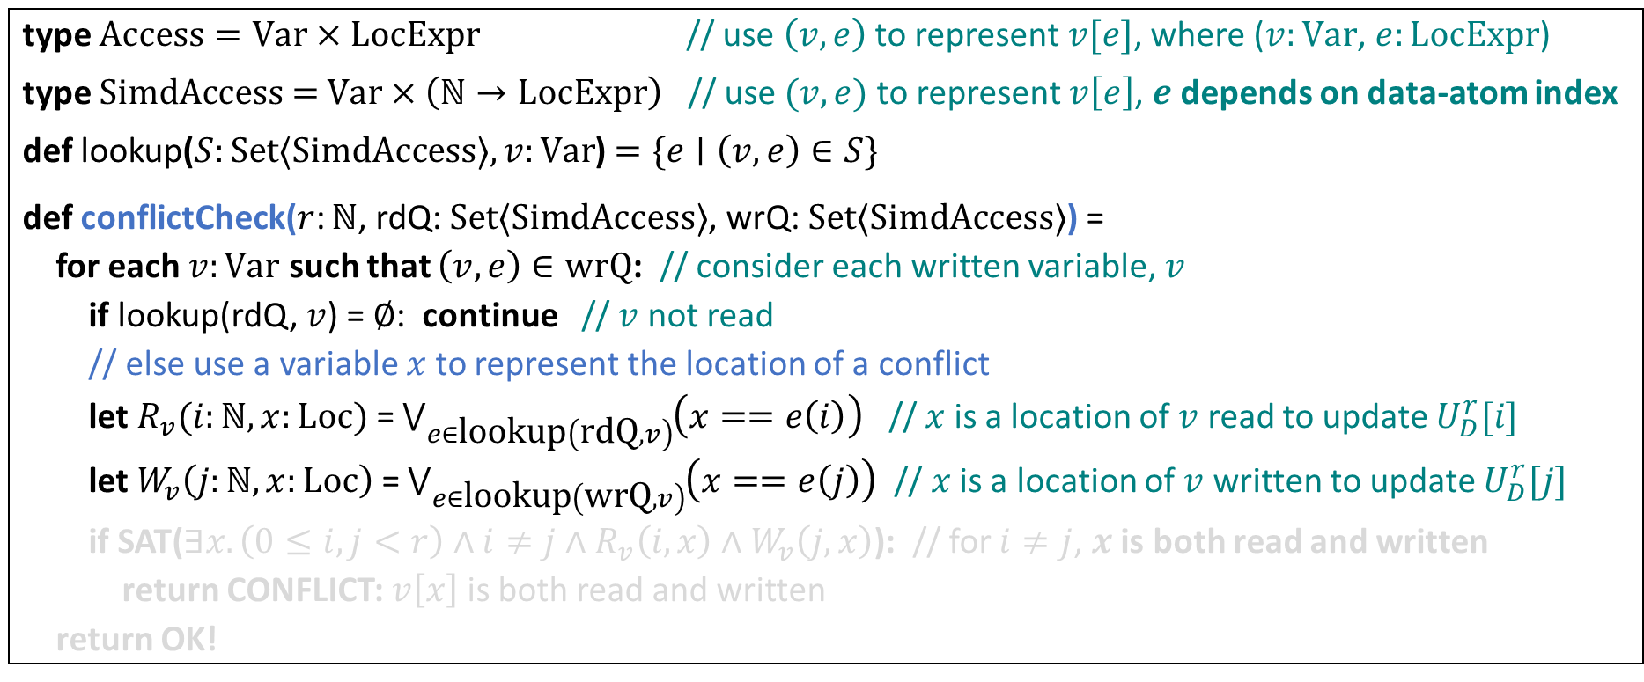
Conflict-freedom check: SMT encoding
Verify: $∀ i,j∈\left[r\right]. \left(i≠j⇒\text{rd}\left(𝒬,i\right)∩\text{wr}\left(𝒬,j\right)=∅\right)$
type $\text{Access}=\text{Var}×\text{LocExpr}$ // use $\left(v, e\right)$ to represent $v[e]$, where ($v:\text{Var}$, $e:\text{LocExpr}$)
type $Simd\text{Access}\text{ = }\text{Var}×\left(ℕ→\text{LocExpr}\right)$ // use $(v, e)$ to represent $v\left[e\right]$, $e$ depends on data-atom index
def lookup($S:\text{Set}⟨\text{SimdAccess}⟩, v:\text{Var}$) $=\{e∣\left(v, e\right)∈S\}$
def conflictCheck($r$: $ℕ$, rdQ: $\text{Set}⟨\text{SimdAccess}⟩$, wrQ: $\text{Set}⟨\text{Simd}\text{Access}⟩$) =
for each $v:\text{Var}$ such that $\left(v, e\right)∈\text{wrQ}$: // consider each written variable, $v$
if lookup(rdQ, $v$) = $∅$: continue // $v$ not read
// else use a variable $x$ to represent the location of a conflict
let $R_{v}(i:ℕ, x:\text{Loc})$ = $\bigvee_{e∈\text{lookup}\left(\text{rdQ}, v\right)}{\left(x==e\left(i\right)\right)}$ // $x$ is a location of $v$ read to update $U_{D}^{r}[i]$
let $W_{v}\left(j:ℕ, x:\text{Loc}\right)$ = $\bigvee_{e∈\text{lookup}\left(\text{wr}\text{Q}, v\right)}{\left(x==e\left(j\right)\right)}$ // $x$ is a location of $v$ written to update $U_{D}^{r}[j]$
if SAT($∃x.\left(0≤i, j<r\right)∧i≠j∧R_{v}\left(i, x\right)∧W_{v}\left(j, x\right)$): // for $i≠j$, $x$ is both read and written
return CONFLICT: $v\left[x\right]$ is both read and written
return OK!

Slide 26
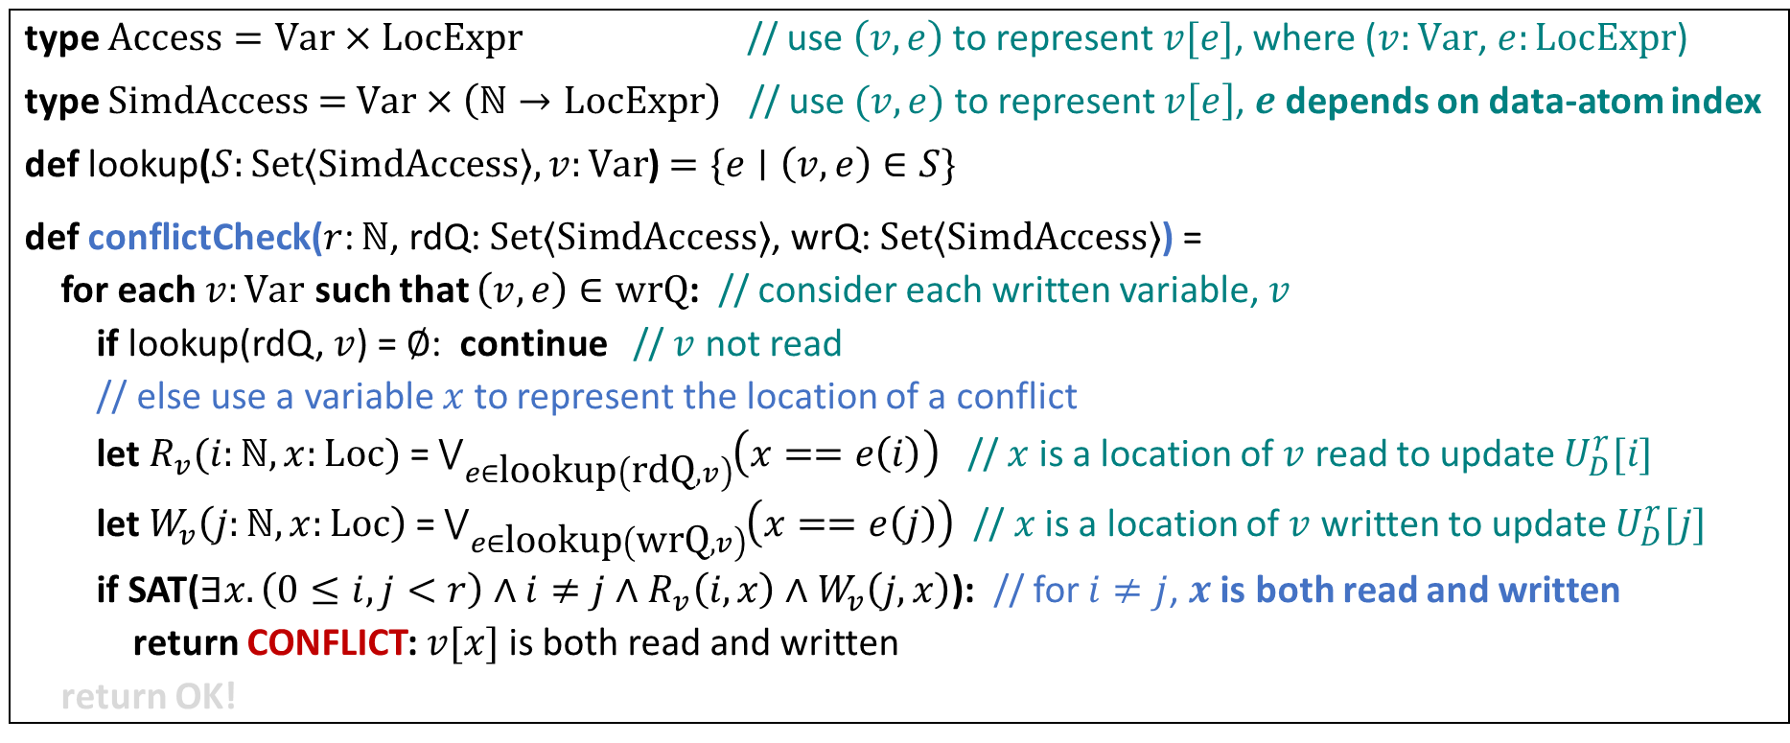
Conflict-freedom check: SMT encoding
Verify: $∀ i,j∈\left[r\right]. \left(i≠j⇒\text{rd}\left(𝒬,i\right)∩\text{wr}\left(𝒬,j\right)=∅\right)$
type $\text{Access}=\text{Var}×\text{LocExpr}$ // use $\left(v, e\right)$ to represent $v[e]$, where ($v:\text{Var}$, $e:\text{LocExpr}$)
type $Simd\text{Access}\text{ = }\text{Var}×\left(ℕ→\text{LocExpr}\right)$ // use $(v, e)$ to represent $v\left[e\right]$, $e$ depends on data-atom index
def lookup($S:\text{Set}⟨\text{SimdAccess}⟩, v:\text{Var}$) $=\{e∣\left(v, e\right)∈S\}$
def conflictCheck($r$: $ℕ$, rdQ: $\text{Set}⟨\text{SimdAccess}⟩$, wrQ: $\text{Set}⟨\text{Simd}\text{Access}⟩$) =
for each $v:\text{Var}$ such that $\left(v, e\right)∈\text{wrQ}$: // consider each written variable, $v$
if lookup(rdQ, $v$) = $∅$: continue // $v$ not read
// else use a variable $x$ to represent the location of a conflict
let $R_{v}(i:ℕ, x:\text{Loc})$ = $\bigvee_{e∈\text{lookup}\left(\text{rdQ}, v\right)}{\left(x==e\left(i\right)\right)}$ // $x$ is a location of $v$ read to update $U_{D}^{r}[i]$
let $W_{v}\left(j:ℕ, x:\text{Loc}\right)$ = $\bigvee_{e∈\text{lookup}\left(\text{wr}\text{Q}, v\right)}{\left(x==e\left(j\right)\right)}$ // $x$ is a location of $v$ written to update $U_{D}^{r}[j]$
if SAT($∃x.\left(0≤i, j<r\right)∧i≠j∧R_{v}\left(i, x\right)∧W_{v}\left(j, x\right)$): // for $i≠j$, $x$ is both read and written
return CONFLICT: $v[x]$ is both read and written
return OK!

Slide 27
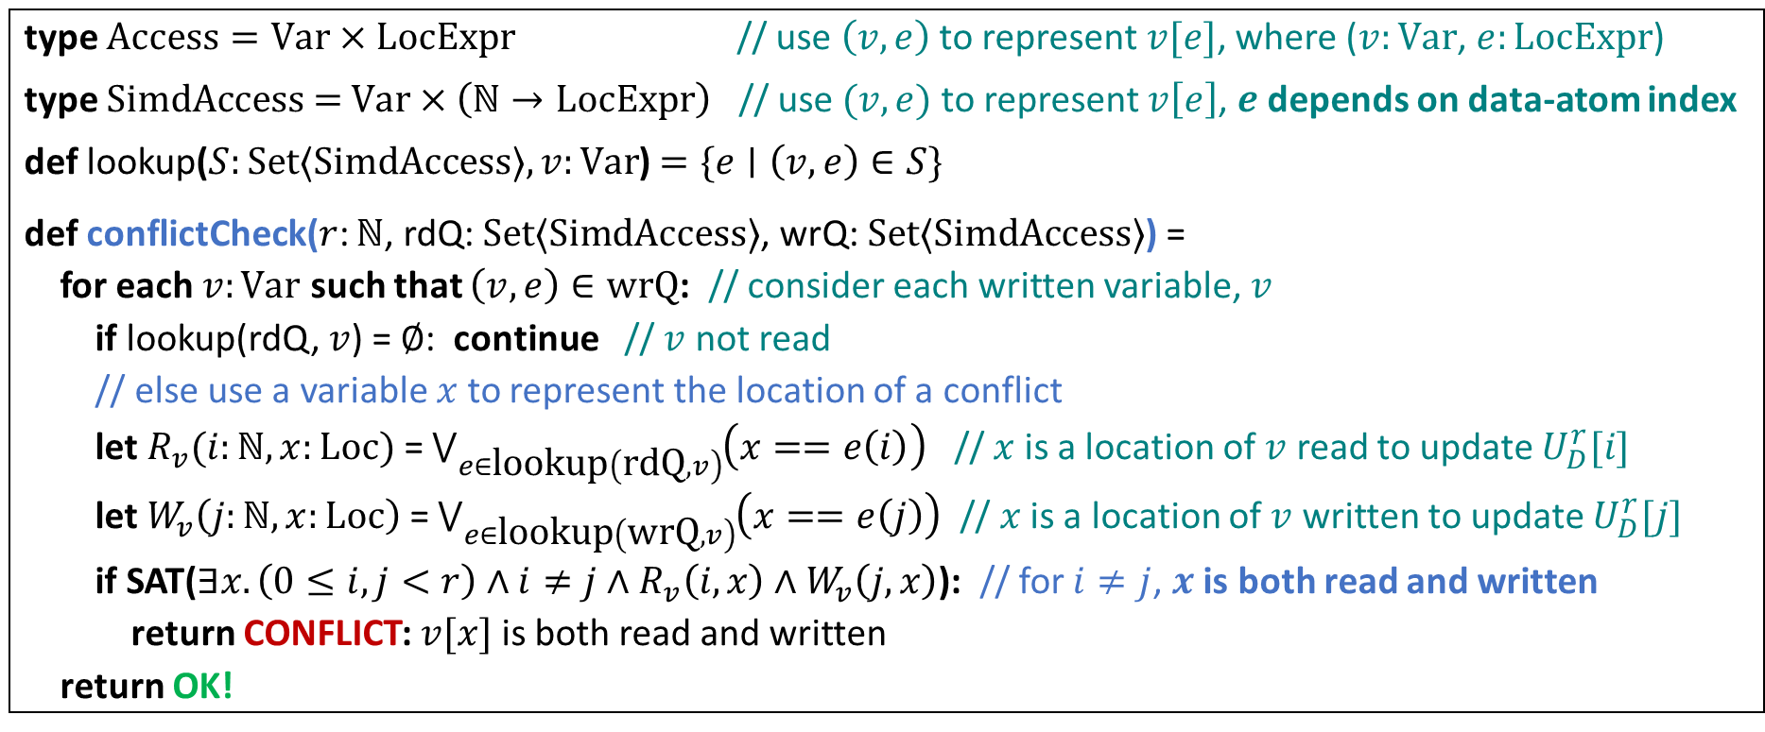
Conflict-freedom check: SMT encoding
Verify: $∀ i,j∈\left[r\right]. \left(i≠j⇒\text{rd}\left(𝒬,i\right)∩\text{wr}\left(𝒬,j\right)=∅\right)$
type $\text{Access}=\text{Var}×\text{LocExpr}$ // use $\left(v, e\right)$ to represent $v[e]$, where ($v:\text{Var}$, $e:\text{LocExpr}$)
type $Simd\text{Access}\text{ = }\text{Var}×\left(ℕ→\text{LocExpr}\right)$ // use $(v, e)$ to represent $v\left[e\right]$, $e$ depends on data-atom index
def lookup($S:\text{Set}⟨\text{SimdAccess}⟩, v:\text{Var}$) $=\{e∣\left(v, e\right)∈S\}$
def conflictCheck($r$: $ℕ$, rdQ: $\text{Set}⟨\text{SimdAccess}⟩$, wrQ: $\text{Set}⟨\text{Simd}\text{Access}⟩$) =
for each $v:\text{Var}$ such that $\left(v, e\right)∈\text{wrQ}$: // consider each written variable, $v$
if lookup(rdQ, $v$) = $∅$: continue // $v$ not read
// else use a variable $x$ to represent the location of a conflict
let $R_{v}(i:ℕ, x:\text{Loc})$ = $\bigvee_{e∈\text{lookup}\left(\text{rdQ}, v\right)}{\left(x==e\left(i\right)\right)}$ // $x$ is a location of $v$ read to update $U_{D}^{r}[i]$
let $W_{v}\left(j:ℕ, x:\text{Loc}\right)$ = $\bigvee_{e∈\text{lookup}\left(\text{wr}\text{Q}, v\right)}{\left(x==e\left(j\right)\right)}$ // $x$ is a location of $v$ written to update $U_{D}^{r}[j]$
if SAT($∃x.\left(0≤i, j<r\right)∧i≠j∧R_{v}\left(i, x\right)∧W_{v}\left(j, x\right)$): // for $i≠j$, $x$ is both read and written
return CONFLICT: $v[x]$ is both read and written
return OK!

Slide 28
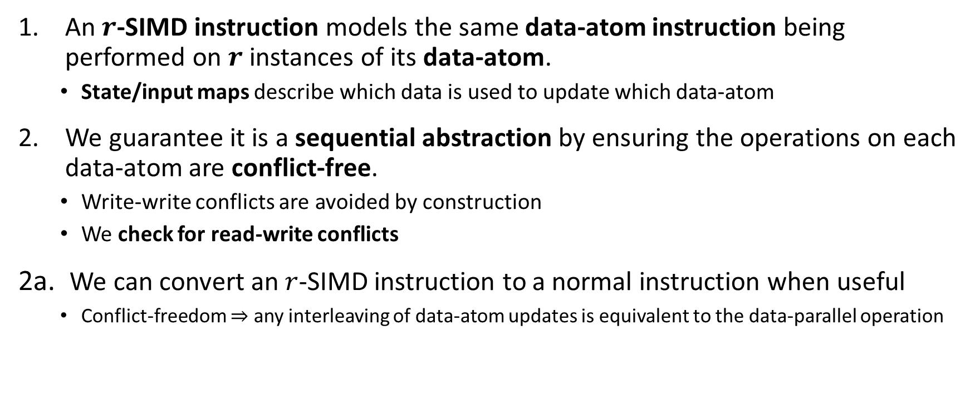
Summing Up SIMD Instructions
An $r$-SIMD instruction models the same data-atom instruction being performed on $r$ instances of its data-atom.
State/input maps describe which data is used to update which data-atom
We guarantee it is a sequential abstraction by ensuring the operations on each data-atom are conflict-free.
Write-write conflicts are avoided by construction
We check for read-write conflicts
2a. We can convert an $r$-SIMD instruction to a normal instruction when useful
Conflict-freedom $⇒$ any interleaving of data-atom updates is equivalent to the data-parallel operation
Notes:
[TODO] “operations on” or “updates to”? As a consequence of point 2, the SIMD instruction being a sequential abstraction, we have…

Slide 29
Challenge example: FlexASR
Notes:
Already given general motivation. Can say this is the “concrete/specific” motivation.

Slide 30
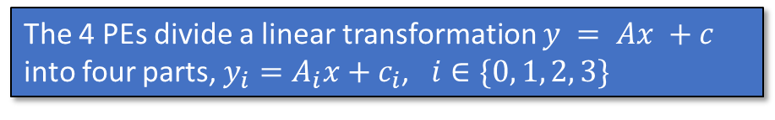
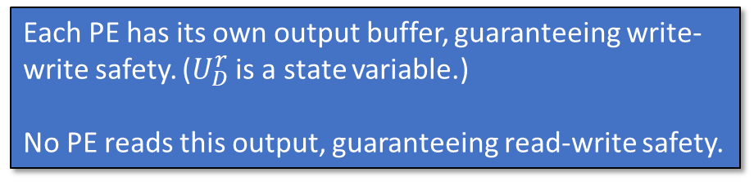
Challenge Example A: Processing Elements for LSTM
The 4 PEs divide a linear transformation $y = Ax +c$ into four parts, $y_{i}=A_{i}x+c_{i}$, $i∈\{0, 1, 2, 3\}$
Each PE has its own output buffer, guaranteeing write-write safety. ($U_{D}^{r}$ is a state variable.)
No PE reads this output, guaranteeing read-write safety.

Slide 31
Challenge Example B: Linear Transformation
Notes:
Already given general motivation. Can say this is the “concrete/specific” motivation.

Slide 32

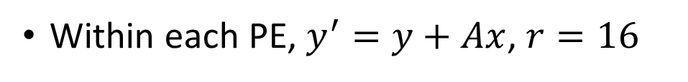








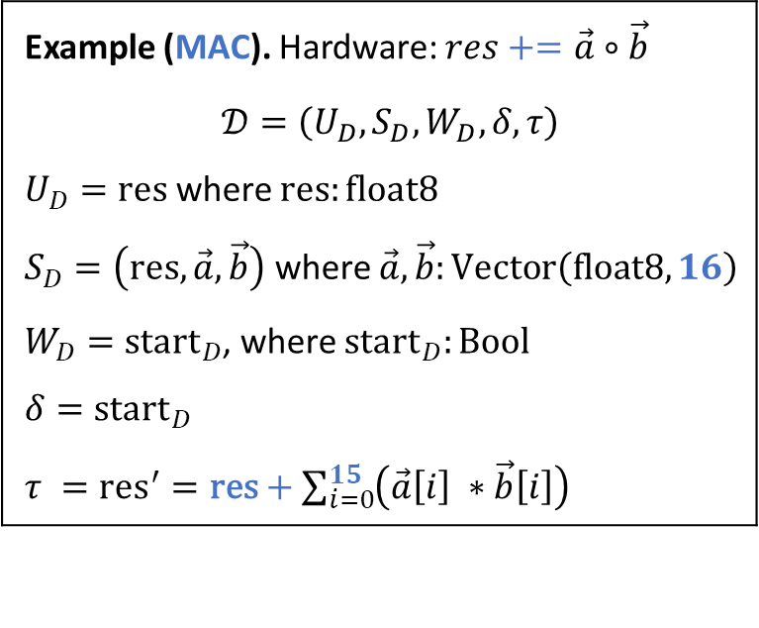
Challenge Example B: Linear Transformation
Within each PE, $y^{′}=y+Ax$, $r=16$
$$×$$
$$+$$
$$=$$
Example (MAC). Hardware: $res+=\vec{a}∘\vec{b}$
$$𝒟=\left(U_{D},S_{D},W_{D}, δ, τ\right)$$
$U_{D}=\text{res}$ where $\text{res}:\text{float}\text{8}$
$S_{D}=\left(\text{res}, \vec{a}, \vec{b}\right)$ where $\vec{a},\vec{b}:\text{Vector}\left(\text{float}\text{8}, 16\right)$
$W_{D}={\text{start}}_{D}$, where ${\text{start}}_{D}:\text{Bool}$
$δ={\text{start}}_{D}$
$τ ={\text{res}}^{′}=\text{res}+\sum_{i=0}^{15}{\left(\vec{a}\left[i\right] ∗\vec{b}\left[i\right]\right)}$
$$A$$
$$x$$
$$y$$
$$y′$$
$$\text{Vector}\left(\text{Vector}\left(\text{float}\text{8}, 16\right), 16\right)$$
$$\text{Vector}\left(\text{float}\text{8}, 16\right)$$
Nearly identical to the previous linear transformation example
$$𝒬=\left(𝒟, r=16, U_{D}^{r}=y,M_{S}(i, S,W)=\left(y\left[i\right], A\left[i\right], x\right),M_{W}=\text{start}\right)$$

Slide 33
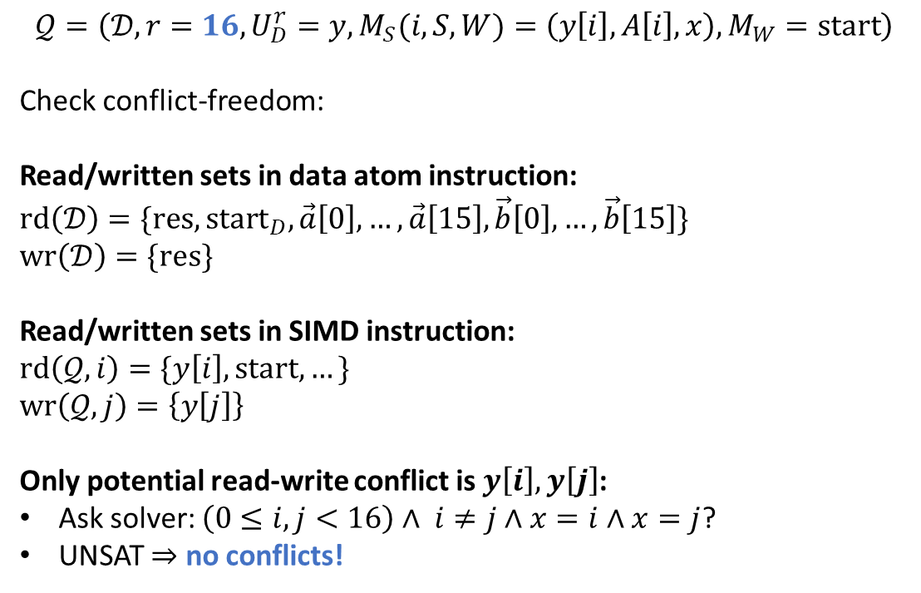
Challenge Example B: 16-Dim. Linear Transformation
$$𝒬=\left(𝒟, r=16, U_{D}^{r}=y,M_{S}(i, S,W)=\left(y\left[i\right], A\left[i\right], x\right),M_{W}=\text{start}\right)$$
Check conflict-freedom:
Read/written sets in data atom instruction: $\text{rd}\left(𝒟\right)=\text{\{}\text{res}, {\text{start}}_{D},\vec{a}\left[0\right], …,\vec{a}\left[15\right], \vec{b}\left[0\right],…,\vec{b}\left[15\right]\}$
$\text{wr}\left(𝒟\right)=\{\text{res}\}$
Read/written sets in SIMD instruction:
$\text{rd}\left(𝒬, i\right)=\{y\left[i\right], \text{start},…\}$
$\text{wr}\left(𝒬, j\right)=\left\{y\left[j\right]\right\}$
Only potential read-write conflict is $y\left[i\right], y\left[j\right]$:
Ask solver: $\left(0≤i,j<16\right)∧ i≠j∧x=i∧x=j$?
UNSAT $⇒$ no conflicts!
Example (MAC). Hardware: $res+=\vec{a}∘\vec{b}$
$$𝒟=\left(U_{D},S_{D},W_{D}, δ, τ\right)$$
$U_{D}=\text{res}$ where $\text{res}:\text{float}\text{8}$
$S_{D}=\left(\text{res}, \vec{a}, \vec{b}\right)$ where $\vec{a},\vec{b}:\text{Vector}\left(\text{float}\text{8}, 16\right)$
$W_{D}={\text{start}}_{D}$, where ${\text{start}}_{D}:\text{Bool}$
$δ={\text{start}}_{D}$
$τ ={\text{res}}^{′}=\text{res}+\sum_{i=0}^{15}{\left(\vec{a}\left[i\right] ∗\vec{b}\left[i\right]\right)}$
Notes:
Mention that here it’s a very simple check

Slide 34
Challenge Example C: Parallel MaxPool (LayerReduction)
Notes:
Already given general motivation. Can say this is the “concrete/specific” motivation.

Slide 35
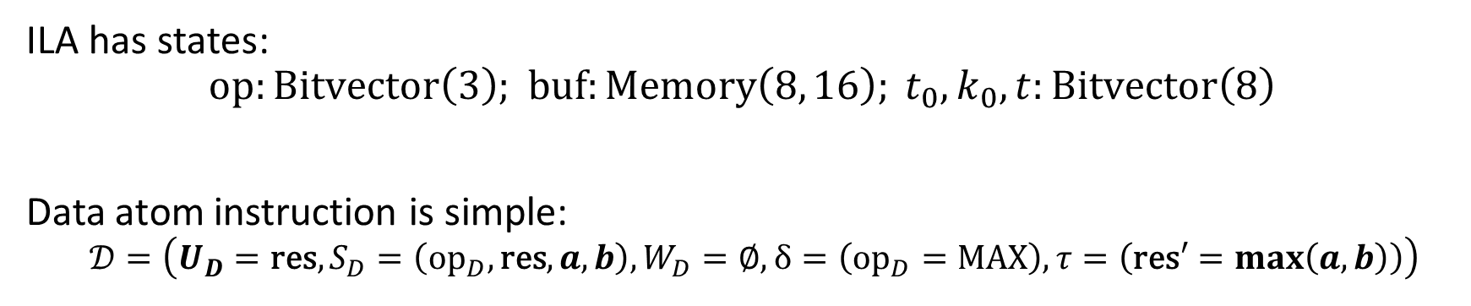
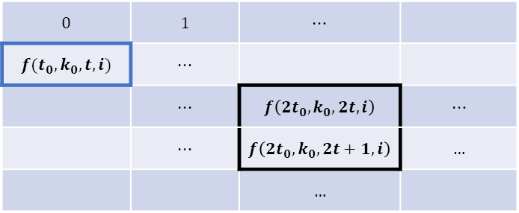
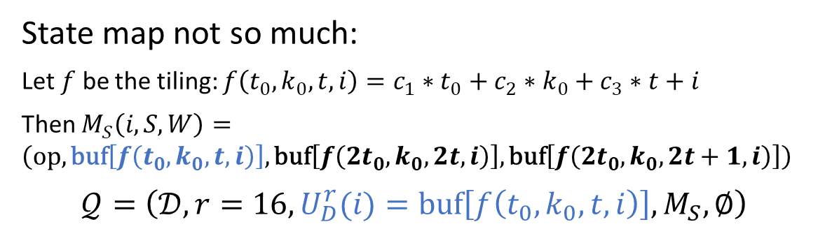
Challenge Example C: 16x Parallel MaxPool (LayerReduction)
ILA has states: $$\text{op}:\text{Bitvector}\left(3\right)\text{; }\text{buf}:\text{Memory}\left(8, 16\right); t_{0},k_{0},t:\text{Bitvector}\left(8\right)$$
Data atom instruction is simple:
$$𝒟=\left(U_{D}=\text{res},S_{D}=\left({\text{op}}_{D}, \text{res},a,b\right), W_{D}=∅, δ=\left({\text{op}}_{D}=\text{MAX}\right),τ=\left(\text{res}′=\max\left(a, b\right)\right)\right)$$
Read/written data all here
Offsets
State map not so much:
Let $f$ be the tiling: $f\left(t_{0},k_{0},t, i\right)={c_{1}∗t}_{0}+c_{2}∗k_{0}+c_{3}∗t+i$
Then $M_{S}\left(i, S,W\right)=\left(\text{op}, \text{buf}\left[f\left(t_{0},k_{0},t, i\right)\right], \text{buf}\left[f\left({2t}_{0},k_{0}, 2t, i\right)\right], \text{buf}\left[f\left(2t_{0}, k_{0}, 2t+1, i\right)\right]\right)$
$$𝒬=\left(𝒟, r=16, U_{D}^{r}(i)=\text{buf}\left[f\left(t_{0},k_{0},t,i\right)\right],M_{S}, ∅\right)$$
$$0$$ | $$1$$ | $$⋯$$
$$f(t_{0},k_{0},t, i)$$ | $$⋯$$
 | $$⋯$$ | $$f\left(2t_{0},k_{0},2t, i\right)$$ | $$⋯$$
 | $$⋯$$ | $$f\left(2t_{0},k_{0},2t+1, i\right)$$ | $$…$$
 |  | $$…$$
Hardware constants: $c_{1}=\text{TGRP}\text{_}\text{SIZE}, c_{2}=\text{HGRP}\text{_}\text{SIZE}, c_{3}=\text{TSTEP}\text{_}\text{SIZE}$.

Slide 36
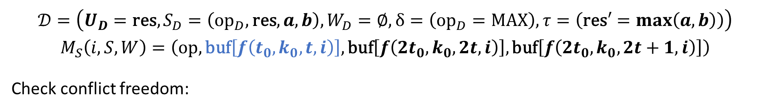
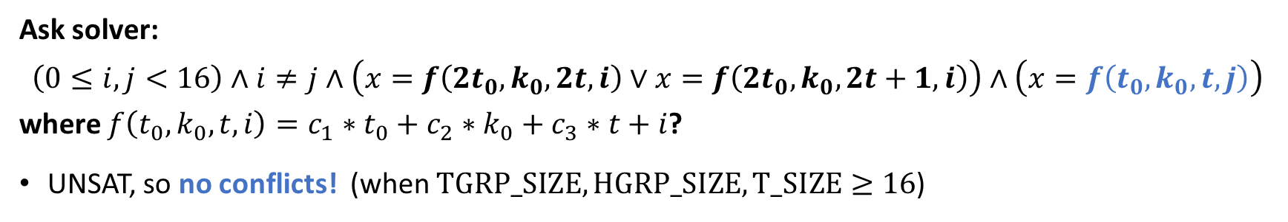
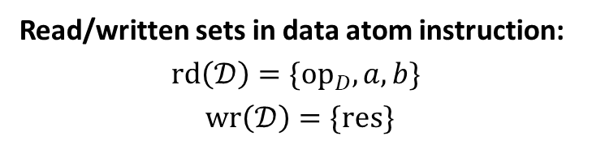
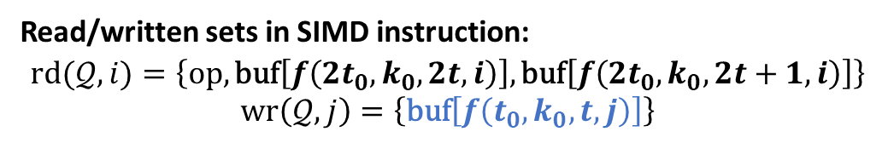
Challenge Example C: 16x Parallel MaxPool (LayerReduction)
$$𝒟=\left(U_{D}=\text{res},S_{D}=\left({\text{op}}_{D}, \text{res},a,b\right), W_{D}=∅, δ=\left({\text{op}}_{D}=\text{MAX}\right),τ=\left(\text{res}′=\max\left(a, b\right)\right)\right)$$
$$M_{S}\left(i, S,W\right)=\left(\text{op}, \text{buf}\left[f\left(t_{0},k_{0},t, i\right)\right], \text{buf}\left[f\left({2t}_{0},k_{0}, 2t, i\right)\right], \text{buf}\left[f\left(2t_{0}, k_{0}, 2t+1, i\right)\right]\right)$$
Check conflict freedom:
Read/written sets in data atom instruction: $$\text{rd}\left(𝒟\right)=\text{\{}{\text{op}}_{D},a, b\}$$
$$\text{wr}\left(𝒟\right)=\{\text{res}\}$$
Read/written sets in SIMD instruction:
$$\text{rd}(𝒬, i)=\left\{\text{op}, \text{buf}\left[f\left({2t}_{0},k_{0}, 2t, i\right)\right],\text{buf}\left[f\left({2t}_{0},k_{0}, 2t+1, i\right)\right]\right\}$$
$$\text{wr}\left(𝒬, j\right)=\left\{\text{buf}\left[f\left(t_{0},k_{0}, t, j\right)\right]\right\}$$
Ask solver: $$\left(0≤i, j<16\right)∧i≠j∧\left(x=f\left(2t_{0},k_{0},2t, i\right)∨x=f\left(2t_{0},k_{0},2t+1, i\right)\right)∧\left(x=f\left(t_{0},k_{0},t, j\right)\right)$$ where $f\left(t_{0},k_{0},t, i\right)={c_{1}∗t}_{0}+c_{2}∗k_{0}+c_{3}∗t+i$?
UNSAT, so no conflicts! (when $\text{TGRP}\text{_}\text{SIZE},\text{HGRP}\text{_}\text{SIZE},\text{T}\text{_}\text{SIZE}≥16$)
Hardware constants: $c_{1}=\text{TGRP}\text{_}\text{SIZE}, c_{2}=\text{HGRP}\text{_}\text{SIZE}, c_{3}=\text{TSTEP}\text{_}\text{SIZE}$.
Notes:
Note that you’re carrying the data-atom and M_S from previous slide, keep (when TGRP_SIZE, …) because it shows it’s the limits of the tiling scheme.

Slide 37
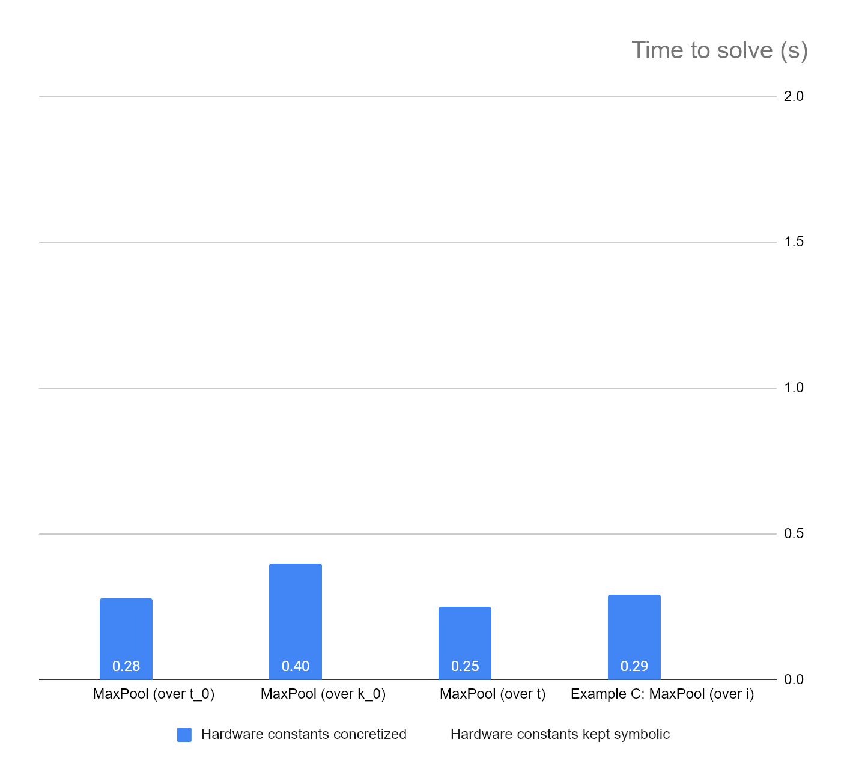

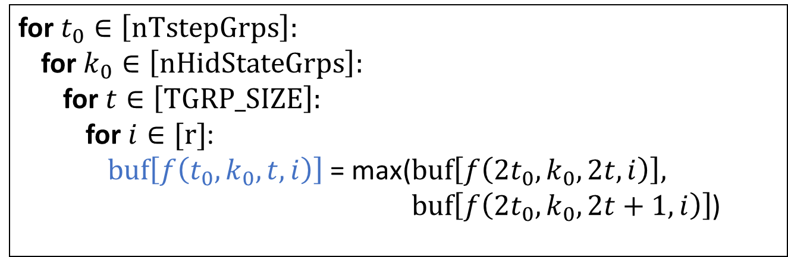
Challenge Example C: How fast is the read-write check?
Examples A, B have trivial checks. Let’s look at C.
Solver returns UNSAT (No conflicts) in 0.29s
Example C is part of a nested loop structure:
for $t_{0}∈\left[\text{nTstepGrps}\right]:$
for $k_{0}∈\left[\text{nHidStateGrps}\right]:$
for $t∈\left[\text{TGRP}\text{_}\text{SIZE}\right]:$
for $i∈[\text{r}]$:
$\text{buf}\left[f\left(t_{0},k_{0},t, i\right)\right]$ = max($\text{buf}\left[f\left({2t}_{0},k_{0}, 2t, i\right)\right],$ $\text{buf}\left[f\left(2t_{0}, k_{0}, 2t+1, i\right)\right]$)
(For demonstration) Let’s check if these loops are SIMD also!
Sequential in hardware
SIMD instruction, $Q$

Slide 38
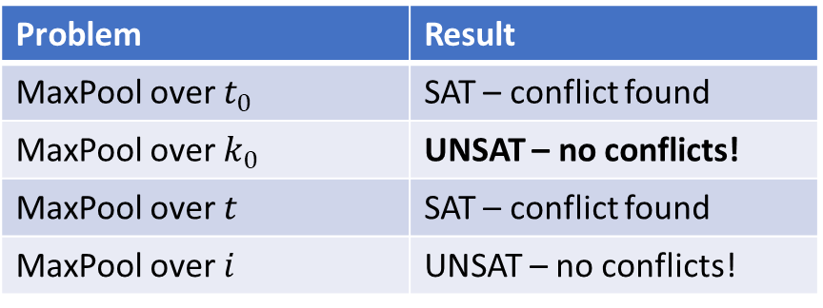
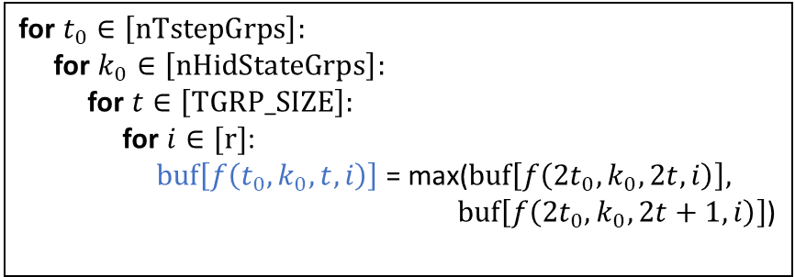

Challenge Example C: How fast is the read-write check?
Caveat
Timing data does not include time to find read/write sets
Opportunity
These results are from modeling the specific hardware of FlexASR, i.e. hardware constants are concretized:
$$\text{TGRP}\text{_}\text{SIZE}=16, \text{HGRP}\text{_}\text{SIZE}\text{ = 16}, \text{TSTEP}\text{_}\text{SIZE}\text{ = 16}$$
Let’s keep these constants symbolic.
Problem | Result
MaxPool over $t_{0}$ | SAT – conflict found
MaxPool over $k_{0}$ | UNSAT – no conflicts!
MaxPool over $t$ | SAT – conflict found
MaxPool over $i$ | UNSAT – no conflicts!
for $t_{0}∈\left[\text{nTstepGrps}\right]:$
for $k_{0}∈\left[\text{nHidStateGrps}\right]:$
for $t∈\left[\text{TGRP}\text{_}\text{SIZE}\right]:$
for $i∈[\text{r}]$:
$\text{buf}\left[f\left(t_{0},k_{0},t, i\right)\right]$ = max($\text{buf}\left[f\left({2t}_{0},k_{0}, 2t, i\right)\right],$ $\text{buf}\left[f\left(2t_{0}, k_{0}, 2t+1, i\right)\right]$)

Slide 39
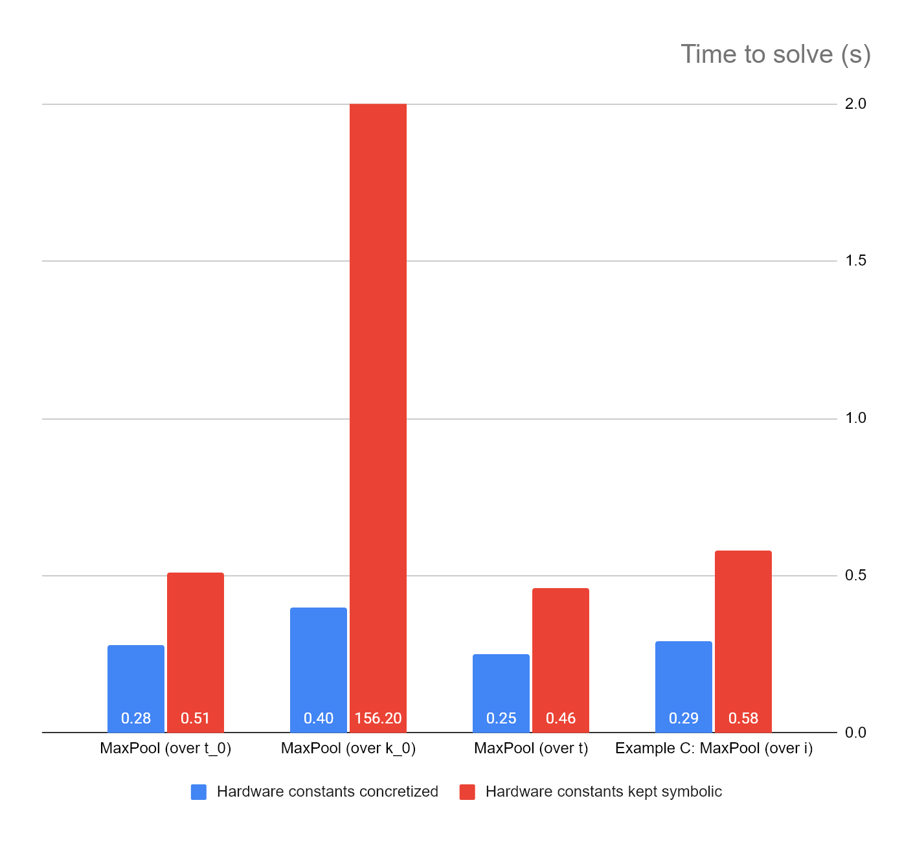

Challenge Example C: How fast is the read-write check?
156s
Hardware constants kept symbolic:
Models families of accelerator designs!
Checking the $k_{0}$ loop might be improved with better invariants
Future work: modeling using CHCs
for $t_{0}∈\left[\text{nTstepGrps}\right]:$
for $k_{0}∈\left[\text{nHidStateGrps}\right]:$
for $t∈\left[\text{TGRP}\text{_}\text{SIZE}\right]:$
for $i∈[\text{r}]$:
$\text{buf}\left[f\left(t_{0},k_{0},t, i\right)\right]$ = max($\text{buf}\left[f\left({2t}_{0},k_{0}, 2t, i\right)\right],$ $\text{buf}\left[f\left(2t_{0}, k_{0}, 2t+1, i\right)\right]$)

Slide 40
Challenge example: FlexASR
Modeled!

Slide 41

Implementation: extending ILAng framework
Extension to ILAng is partially implemented:
Added support for vectors and records as syntactic sugar
Some utilities for making disjoint $U_{D}^{r}$ (write-write safety by construction)
Preliminary read-write check implemented
Further improvements:
Vectors/records should be part of expressions
Integrate read-write check with ILAng models

Slide 42
Summary so far
How do we extend ILA to model data-parallelism in accelerators?
Use SIMD instructions to encapsulate the data-parallel portion!
Can we maintain the view of sequential abstractions (to ease verification)?
Yes, by ensuring conflict-freedom!
Next question: we have an abstraction, what can we do with it?

Slide 43
Outline
Background: Instruction Level Abstraction (ILA)
SIMD (Single Instruction, Multiple Data) Instructions
Nested SIMD Instructions, SIMD Transformations
Key Points
Related Work
Future Work

Slide 44

































Nested SIMD Instructions
Definition of a data atom instruction: $𝒟=(U_{D},S_{D},W_{D}, δ, τ)$
Just showed:
$r$-SIMD instructions can be used like standard ILA instructions
A standard ILA instruction (that only writes to $U_{D}$)
$W_{0}$
$W_{1}$
$W_{r_{1}−1}$
$W_{0}$
$W_{1}$
$W_{r_{2}−1}$
$W_{0}$
$W_{1}$
$W_{r_{n}−1}$
Potentially different $r$
…
…
…
$S_{0}$
$S_{1}$
$S_{r_{1}−1}$
$S_{0}$
$S_{1}$
$S_{r_{2}−1}$
$S_{0}$
$S_{1}$
$S_{r_{n}−1}$
same operation, $$𝒬$$
…
$S_{0}′$
$S_{1}′$
…
$S_{r_{1}−1}′$
$S_{0}′$
$S_{1}′$
…
$S_{r_{2}−1}′$
$S_{0}′$
$S_{1}′$
…
$S_{r_{n}−1}′$
$n$ data-atoms, each is a $\text{Vector}$
$Q$ = $\left(D, r_{∗}, U_{D}^{r_{∗}}, M_{S},M_{W}\right)$,
$𝒬_{\text{nested}}=\left(𝒬, n, U_{D}^{n}, {M_{S}}_{nested},{M_{W}}_{nested}\right)$
Notes:
Hardware

Slide 45










































SIMD Transformation: Flattening
$𝒬_{\text{nested}}=\left(𝓠, n, U_{D}^{n}, {M_{S}}_{\text{nested}},{M_{W}}_{\text{nested}}\right)$, $𝓠=(𝓓,…)$
$$𝒬_{\text{flat}}=\left(𝓓, R, U_{D}^{R}, {M_{S}}_{flat},{M_{W}}_{flat}\right)$$
$W_{0}$
$W_{1}$
$W_{r_{1}−1}$
$W_{0}$
$W_{1}$
$W_{r_{2}−1}$
$W_{0}$
$W_{1}$
$W_{r_{n}−1}$
$W_{0}$
$W_{1}$
$W_{R−2}$
$W_{R−1}$
…
…
…
…
$S_{0}$
$S_{1}$
$S_{r_{1}−1}$
$S_{0}$
$S_{1}$
$S_{r_{2}−1}$
$S_{0}$
$S_{1}$
$S_{r_{n}−1}$
$S_{0}$
$S_{1}$
$S_{R−2}$
$S_{R−1}$
…
$S_{0}′$
$S_{1}′$
…
$S_{r_{1}−1}′$
$S_{0}′$
$S_{1}′$
…
$S_{r_{2}−1}′$
$S_{0}′$
$S_{1}′$
…
$S_{r_{n}−1}′$
$S_{0}′$
$S_{1}′$
…
$S_{R−2}′$
$S_{R−1}′$
$$R=\sum_{i=1}^{n}{r_{i}}$$
Can flatten nested $r$-SIMD instructions into an $R$-SIMD instruction
Write-write safety is guaranteed by disjointness of $U_{D}^{n}$
Read-write safety is guaranteed by conflict-freedom checks at each nesting level
Like this, other loop transformations can be implemented
E.g. loop reordering, loop fusion

Slide 46
Summary of Key Points
SIMD instructions allow us to
model hardware data-parallelism and
preserve a sequential view of hardware
We check conflict-freedom to ensure the sequential abstraction
This approach allows us to further raise the level of abstraction via loop transformations

Slide 47
Related Work
Data-parallelism and loop transformations
Halide | Ragan-Kelley, Jonathan, et al. "Halide: a language and compiler for optimizing parallelism, locality, and recomputation in image processing pipelines." Acm Sigplan Notices 48.6 (2013): 519-530.
Verification of programs on parallel hardware
GPUVerify | Betts, Adam, et al. "GPUVerify: a verifier for GPU kernels." Proceedings of the ACM international conference on Object oriented programming systems languages and applications. 2012.
ILA | Huang, Bo-Yuan, et al. "Formal security verification of concurrent firmware in SoCs using instruction-level abstraction for hardware." 2018 55th ACM/ESDA/IEEE Design Automation Conference (DAC). IEEE, 2018.
 | Zhang, Hongce, et al. "ILA-MCM: Integrating Memory Consistency Models with Instruction-Level Abstractions for Heterogeneous System-on-Chip Verification." 2018 Formal Methods in Computer Aided Design (FMCAD). IEEE, 2018.

Slide 48
Future Work
More design patterns with parallelism/SIMD
Support transformations on SIMD instructions: loop reordering, loop fusion
Other types of structured parallelism: reductions, producer-consumer
Supporting ILA-based verified compilation
ILA program fragment verification
CHC-based techniques
Compiler-side
ILA
Accelerator-side ILA
FlexASR func A:
instr. 1 (STR r2, 0xffff0000)
instr. 2 (LDR r3, 0xffff0010)
FlexASR func B:
instr. 3 (STR r2, 0xffffaa00)
instr. 4 (LDR r3, 0xffffaabb)
NVDLA func C:
instr. 5 (STR r4, 0xffff0100)
instr. 6 (LDR r5, 0xffff0110)
Notes:
Can use “Supporting ILA-based verified compilation“ to lead into 3LA project

